Slide 1

Colliders
Tom LeCompte
High Energy Physics Division
Argonne National Laboratory
Present address:
Office of High Energy Physics
Office of Science SC-25
US Department of Energy

Slide 2

Before We Take Off
STOP ME if I go too fast or you have questions!!
I know I talk too fast, so please interrupt me – my goal is not to cover as much
material as possible: it’s to uncover as much material as possible

Slide 3

Syllabus
These lectures will be backwards. I plan to start with something specific and then work my way to the more general.
Higgs Discovery
Hadron Colliders and Detectors
Electron Colliders
What Did We Learn from the LHC?
Future Colliders

Slide 4


Thanks to the Organizers
Thanks for the opportunity to talk about physics near and dear to my heart, and…
Thanks for the opportunity to return to the land of my ancestors
The part where the LeComptes are from
The part with a sensible climate

Slide 5
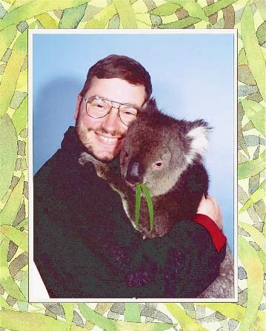
Who Is This Guy?
I got my PhD in 1992 on E-705, a Fermilab fixed target charmonium experiment.
I then moved into hadron collider physics, and have worked at pretty much every such collider:
  CDF at the Tevatron
  STAR at RHIC
  ATLAS at the LHC
Recently I was the physics coordinator of ATLAS
I have worked on QCD/Heavy Flavor Production, SUSY and Higgs.
This is a picture of a small, round-faced, adorable creature.
Holding a koala.

Slide 6
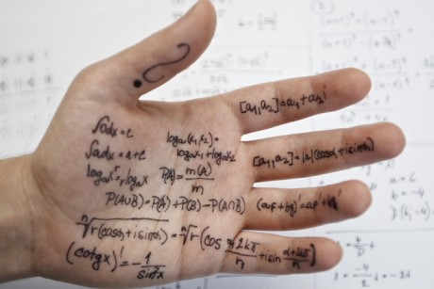
Cheating Already? On Slide 6?
I was charged with talking about colliders, and will
use the Higgs discovery as a framework
I’m actually going to do this!
But not as a death march through a jungle of plots and tables. Instead I want to highlight
  What we know and how we know it
  What we would like to know
  How we might go about doing this
  With examples from ATLAS, CMS and elsewhere when appropriate
With only four lectures, there will inevitably be some omissions and oversimplifications

Slide 7
Spontaneous Symmetry Breaking
What is the least amount of railroad track needed to connect these 4 cities?

Slide 8
One Option
I can connect them this way at a cost of 4 units.
(length of side = 1 unit)

Slide 9
Option Two
I can connect them this way at a cost of only 3 units.

Slide 10
Option Three
This requires only

Slide 11
The Real Optimal Solution
This requires
Note that the symmetry of the solution is lower than the symmetry of the problem: this is the definition of Spontaneous Symmetry Breaking.
+
n.b. The sum of the solutions has the same symmetry as the problem.

Slide 12
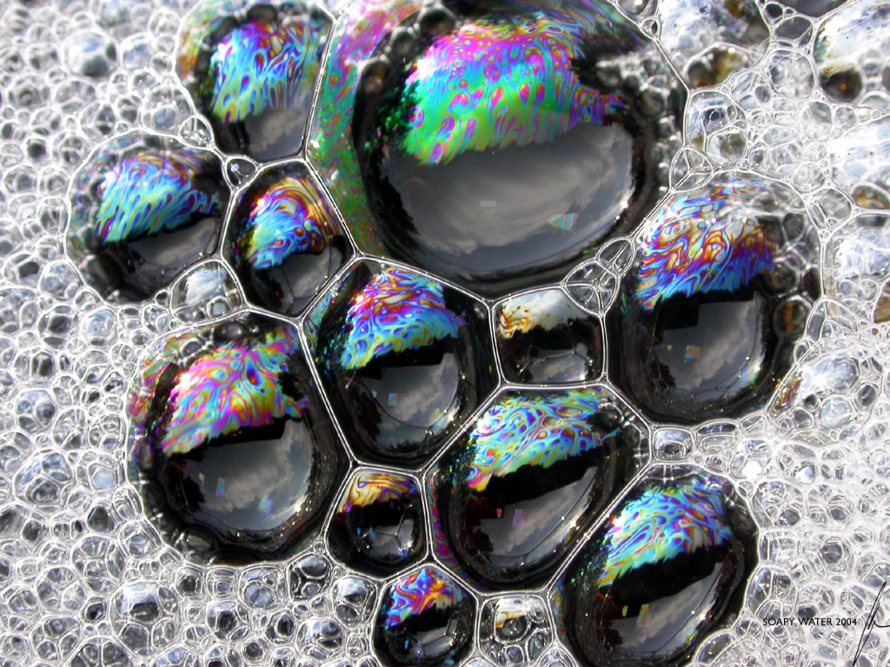
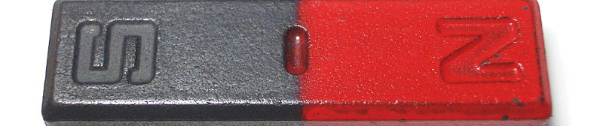
A Pointless Aside
One might have guessed at the answer by looking at soap bubbles, which try to minimize their surface area.
But that’s not important right now…
Another Example of Spontaneous Symmetry Breaking
Ferromagnetism: the Hamiltonian is fully spatially symmetric, but the ground state has a non-zero magnetization pointing in some direction.

Slide 13
The Higgs Mechanism
Write down a theory of massless weak bosons
  The only thing wrong with this theory is that it doesn’t describe the world in which we live
Add a new doublet of spin-0 particles:
  This adds four new degrees of freedom
  (the doublet + their antiparticles)
Write down the interactions between the new doublet and itself, and the new doublet and the weak bosons in just the right way to
  Spontaneously break the symmetry: i.e. the Higgs field develops a non-zero vacuum expectation value
    Like the magnetization in a ferromagnet
  Allow something really cute to happen

Slide 14
The Really Cute Thing
The massless w⁺ and φ⁺ mix.
  You get one particle with three spin states
    Massive particles have three spin states
  The W has acquired a mass
The same thing happens for the w⁻ and φ⁻
In the neutral case, the same thing happens for
one neutral combination, and it becomes the massive Z⁰.
The other neutral combination doesn’t couple to the Higgs, and it gives the massless photon.
That leaves one degree of freedom left, and because of the non zero v.e.v. of the Higgs field, produces a massive Higgs.
m = ±1 “transverse”
m = 0 “longitudinal”

Slide 15

How Cute Is It?
There’s very little choice involved
in how you write down this theory.
  There’s one free parameter
  which determines the Higgs
  boson mass
  There’s one sign which
  determines if the symmetry
  breaks or not.
The theory leaves the Standard Model mostly untouched
  It adds a new Higgs boson – which we can look for
  It adds a new piece to the WW → WW cross-section
    This interferes destructively with the piece that was already there and restores unitarity
In this model, the v.e.v. of the Higgs field is the Fermi constant
  This shows the deep connection between the Higgs and the weak interaction

Slide 16
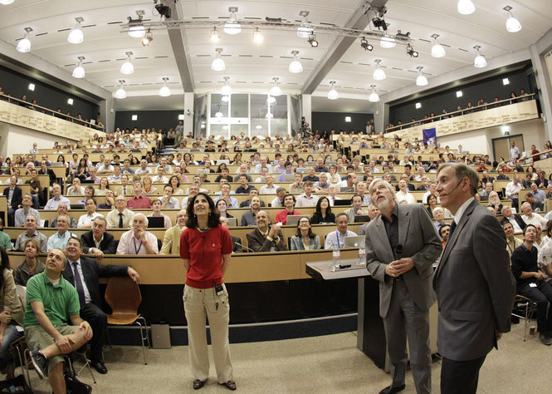
Onto the Higgs Boson Discovery

Slide 17
Higgs Production
“VBF”
“associated production”
Glue-glue initiated production dominates
VBF is a ~10% contribution:
  Can be larger or smaller than this depending on the analysis
Associated production is a small piece, only useful in high background regions
And…

Slide 18
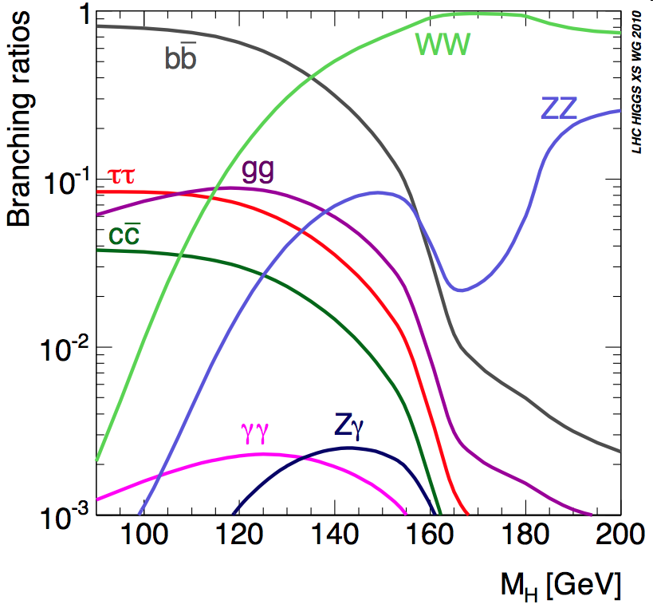
Higgs Decays
The Higgs wants to decay to heavy gauge bosons if it can. (That’s its job)
Otherwise, it wants to decay into the heaviest fermions it can (That’s its other job)
Modes like γγ occur at one-loop and are suppressed by a factor of ~1000.

Slide 19
More Higgs Decays
Lesson: Logarithmic plots can be horribly misleading.
  The above shows the relative decays for a ~125 GeV Higgs.
Question: Why on earth would anyone design an analysis around this little sliver?

Slide 20
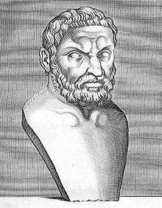
Digression – the Inventor of the “Cut”
One of the Seven Wise Men of ancient Greece
  Pre-Socratic (and thus pre-Aristotle) philosopher
  Pre-Euclid mathematician
  First to predict a solar eclipse
  Early speculator in commodities
    According to Aristotle, predicting a strong harvest, he rented all the olive presses at a discount early in the season and re-rented them at a premium when the olives came in.
Measured the height of the Pyramids
  Without Euclidian geometry (which wouldn’t be invented for centuries)
  Thales recognized that twice a day this measurement is easy; twice a day an object’s shadow is the same length as the object.
Thales of Miletus
(c. 624 BCE – 526 BCE)

Slide 21
Higgs Decays
Decay Mode | Branching Fraction | Useful Branching fraction | Background Level
Bottom quarks | 60% | 30% | Tens of thousands:1
WW* | 15% | ~2% | Few:1
ZZ* | 4% | 0.014% | Comparable
gluons | 10% | 10% | Millions:1
taus | 8% | 6% | A long story
Charm quarks | 6% | 3% | Tens of thousands:1
Two photons | 0.2% | 0.2% | Few:1
For a ~125 GeV Higgs
The quantity of signal is but one element in designing an analysis. The level of background is at least as important. While I will only barely touch on it at the moment, so is triggerability: you cannot analyze an event that you didn’t record.

Slide 22
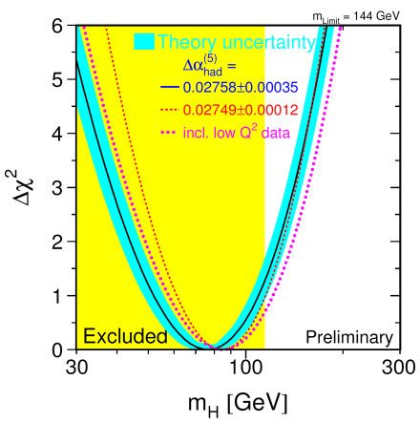
Pre-Search
Indirect measurements (loop contributions to m_{W} and m_{t}) suggest the Higgs is light.
The assumption in these plots is that there are no other particles (e.g. supersymmetric ones) that also contribute to these loops.
My conclusion (not universally held)
  The Higgs can be anywhere between 114 GeV (experimental limit) and ~1 TeV (theoretical limit)

Slide 23
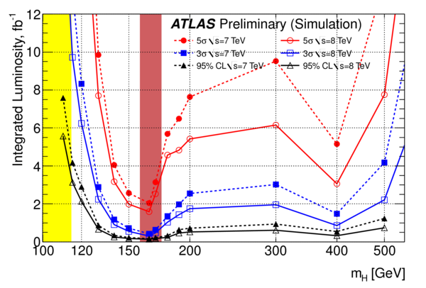
Pre-LHC Search
Excluded by LEP
Excluded by the Tevatron

Slide 24
Channel-by-Channel

Slide 25
Channel-by-Channel

Slide 26
Channel-by-Channel

Slide 27
Channel-by-Channel
Plus some

Slide 28
Where Are We After Step #0?
We will look at H → γγ.
  This favors the lowest possible range of Higgs masses.
  It’s produced 90% through gg-fusion and 10% through VBF
  Tiny branching fraction, but reasonable S/B ratio
Other people will look at H → WW*
Still other people will look at H → ZZ*
And still other people will look for “specialized” Higgs decays
  Heavy Higgs
  Charged Higgs
  Supersymmetric Higgs
Step #0 is a critical part to an analysis – doing the spadework of thinking about what one is doing, why one is doing, what the strategy is, how that strategy is informed by what we already know (sometimes mistakenly called “theory”).

Slide 29
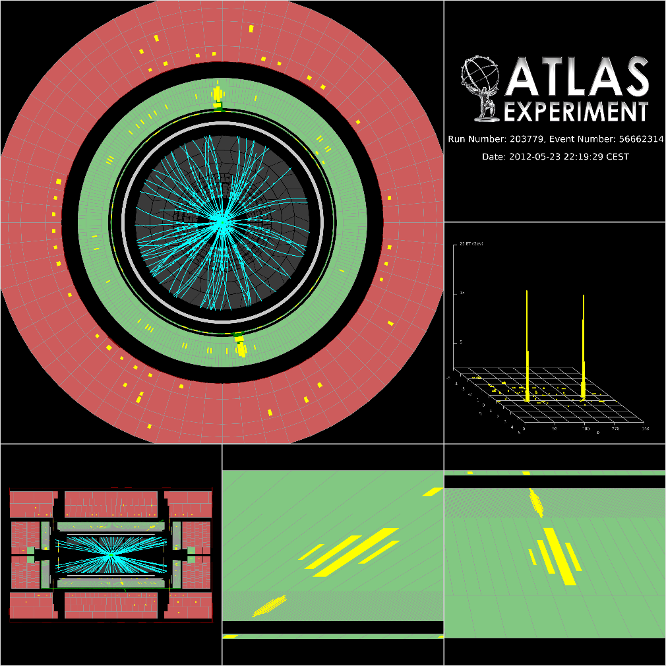
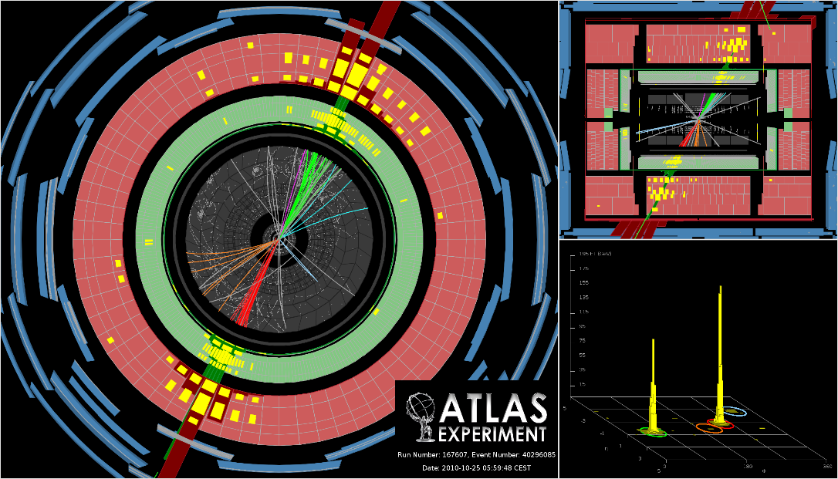
Identifying Photons
We need to separate this…
From this…
Only a small fraction of jets* can mimic a photon – but there are a lot of jets!
* A jet is a collimated “spray” of hadrons – more later

Slide 30
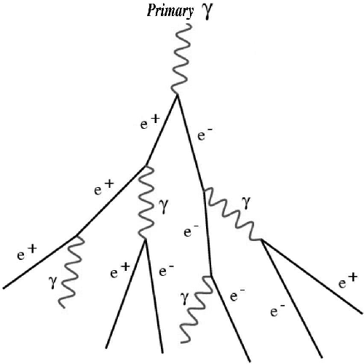

Identifying Photons – Basics of Calorimeter Design
n.b. these are the very same showers Francis was talking about Monday
Not too much or too little energy here.
You want exactly one photon – not 0 (a likely hadron) or 2 (likely π⁰)
Not too wide here.
One photon and not two nearby ones (again, a likely π⁰)
Not too much energy here.
A schematic of an electromagnetic shower
Indicative of a hadronic shower: probably a neutron or K_{L}.
A GEANT simulationof an electromagnetic shower

Slide 31
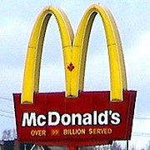
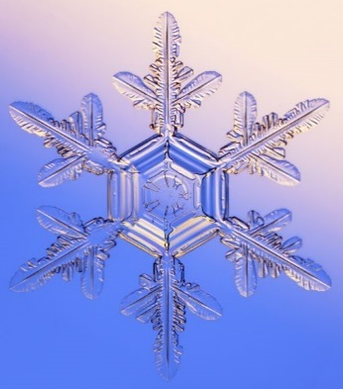
Identifying Photons – Basics of Calorimeter Design
EM showers all look the same
Hadronic showers – and jets - are like snowflakes
  Every one is unique
A schematic of an electromagnetic shower
A GEANT simulationof an electromagnetic shower

Slide 32
ATLAS Electromagnetic Calorimeter
Design resolution:
Technology: uses lead as an absorber and liquid argon as an ionization medium. Energy deposited in the calorimeter is converted to an electrical signal.

Slide 33
ATLAS Liquid Argon Calorimeter Module
Highly segmented
  Allows measurement of shower development
    Rejects background
  Has some pointing ability
Very good (but not as good as CMS) energy resolution
“Accordion” faster than
other LAr calorimeters
  Still slower than crystals

Slide 34
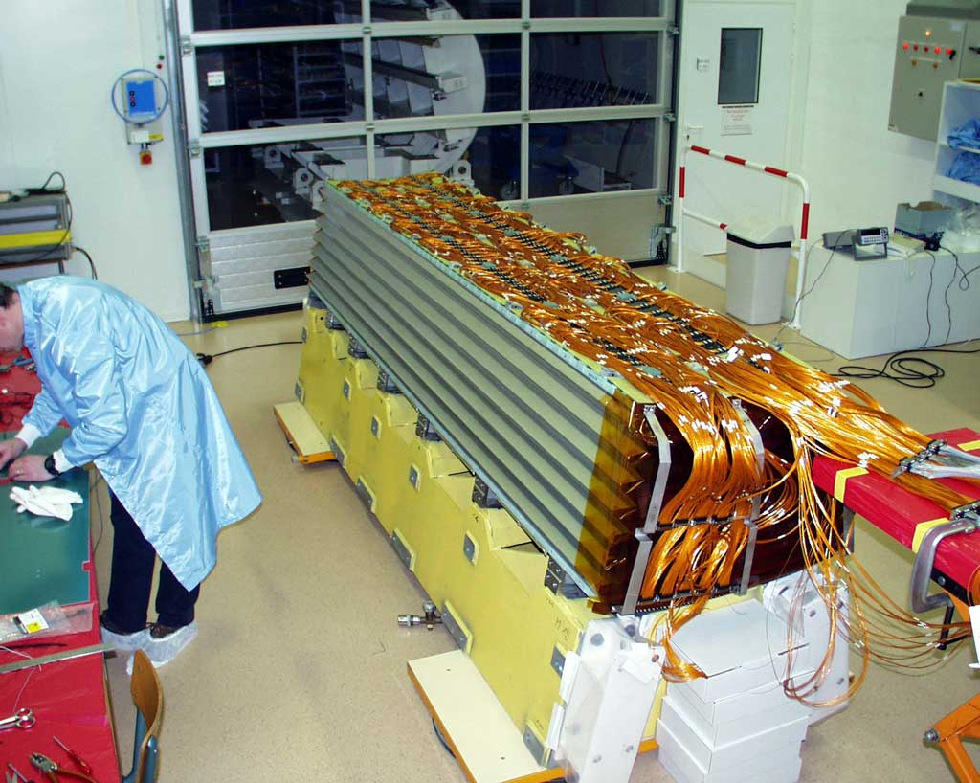
ATLAS Calorimeter in Real Life
Before installation – it’s now in a cryostat and impossible to see.

Slide 35
CMS Calorimeter Crystals
16X₀
CMS uses Lead Tungstate crystals
  Scintillator: energy is converted to light
  Exceptional energy resolution, because there are no inert absorbers
The focus is to get the best possible energy resolution, no matter what it takes
  Ultimate energy resolution is ~2x better than ATLAS’ in the region where Higgs decay is important
22X₀
26X₀
Design resolution:
Another nice feature – low noise
Photo: Ren-yuan Zhu, Caltech

Slide 36
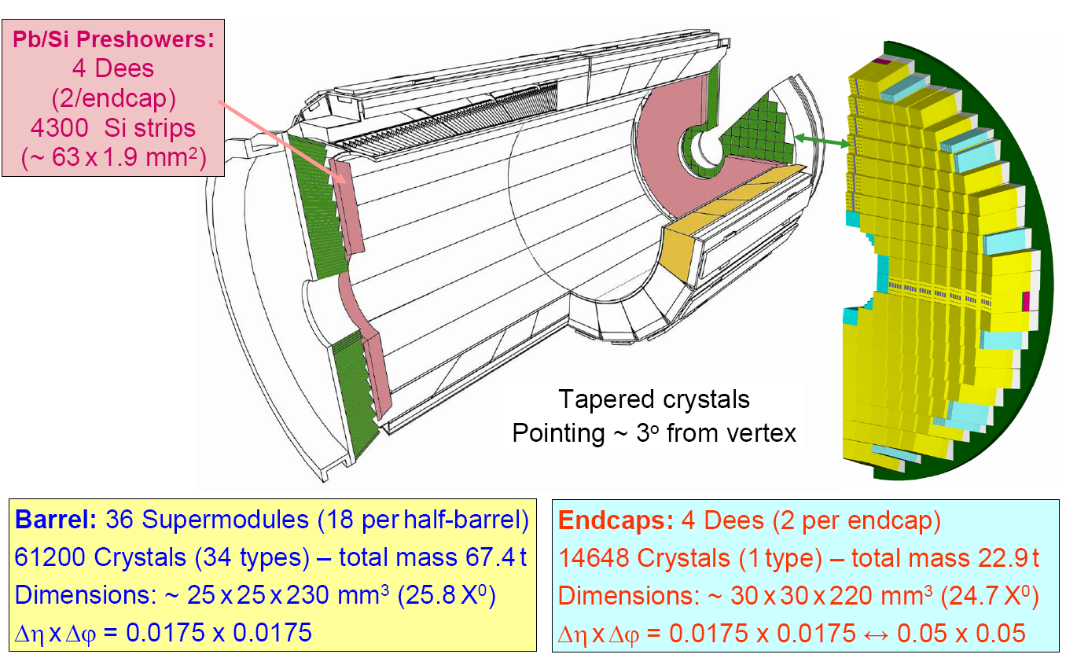
CMS EM Calorimeter
Figure: Ren-yuan Zhu, Caltech

Slide 37
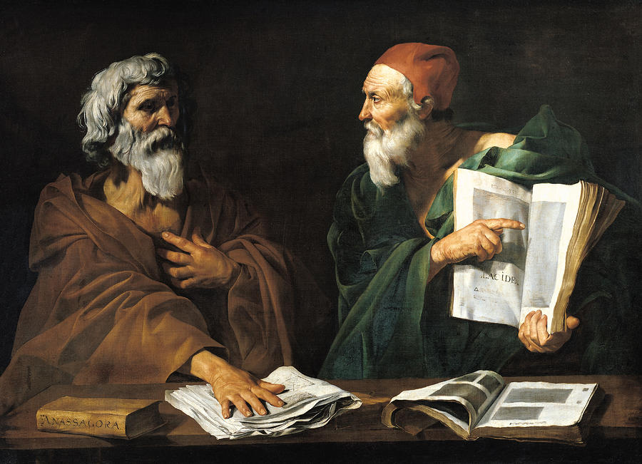
Comparing Design Philosophies
CMS emphasizes energy resolution
  Use PWO crystals
    Expensive – means go to small
    radius to keep the detector within budget and schedule.
    Only handful of vendors worldwide
ATLAS emphasizes background rejection
  Able to go to larger radius: separates showers better
  Highly segmented calorimeter allows measurement of shower development
    One photon? Two? A hadron masquerading as a photon?
Both calorimeters are quite thick
  Improves resolution (showers are contained)
  Degrades electron-hadron separation
    ATLAS measurement of shower development is intended to compensate

Slide 38
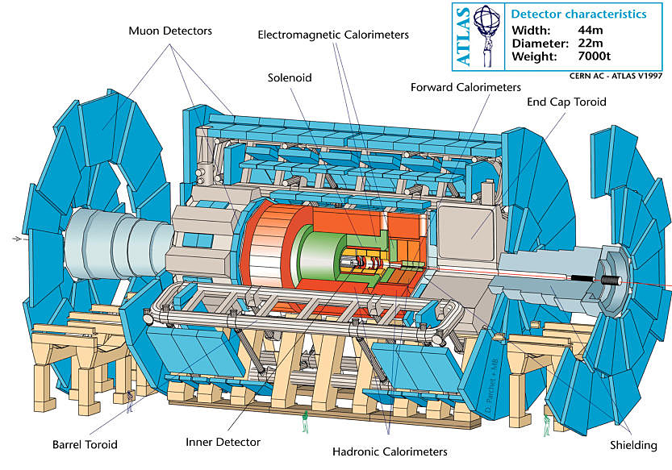
ATLAS

Slide 39
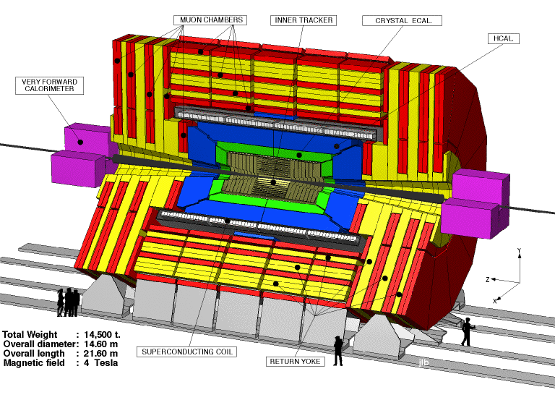
CMS: The Other LHC “Large” Detector
Different detector technologies
  e.g. iron core muon spectrometer vs. air core
  Crystal calorimeter vs. liquid argon
Different design emphasis
  e.g. their EM calorimeter is optimized more towards precise measurement of the signal; ATLAS is optimized more towards background rejection
Similar in concept to ATLAS,
but with a different execution.

Slide 40
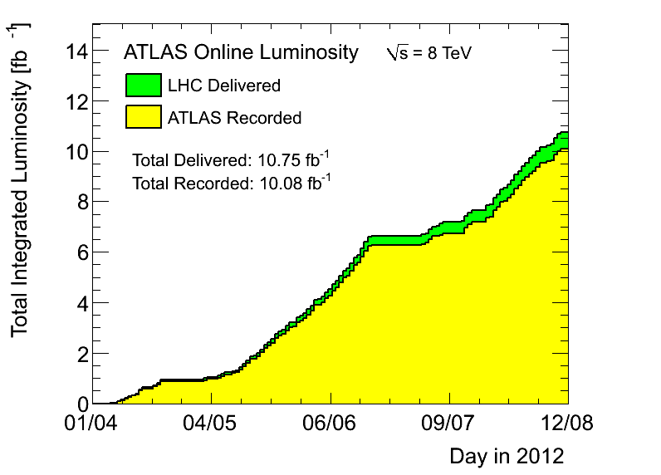
I Like Working at the LHC…

Slide 41
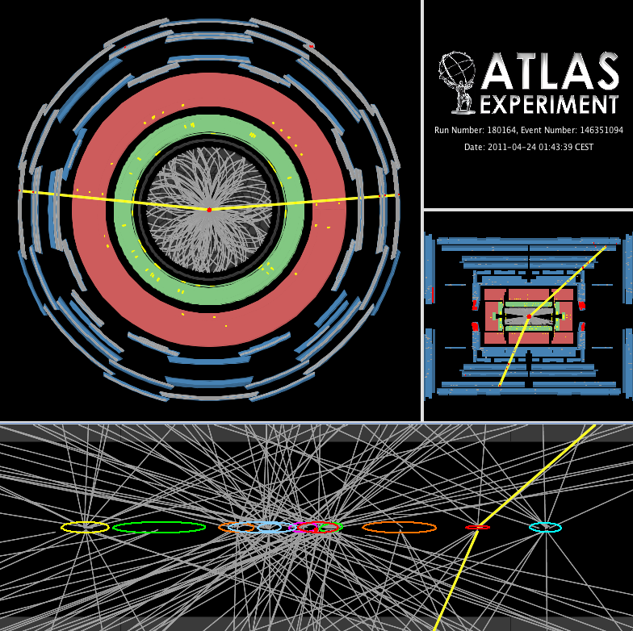
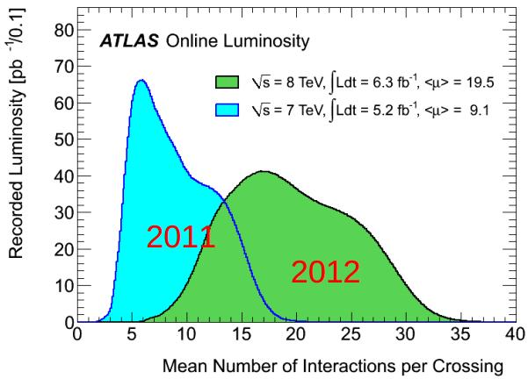
…But I Miss Working At The Tevatron
This is a Z event (into muons) with only 11 primary vertices.
Not a showstopper, but it is work.

Slide 42
Where Are We After Step #1?
We’ve identified the problem:
We need to identify Higgs γγ events over three backgrounds…
  Other γγ events
  Jet+γ events misidentified as γγ
    About 1000x larger
  Dijet events misidentified as γγ
    About 1000000x larger
… in the face of a large number of pile-up events
QCD kinda-sorta predicts these rates: well enough that we can tell we are on the right path, but nowhere near well enough to discover the Higgs by looking at total rates.
The tool that lest us solve this is the “ABCD Method”

Slide 43
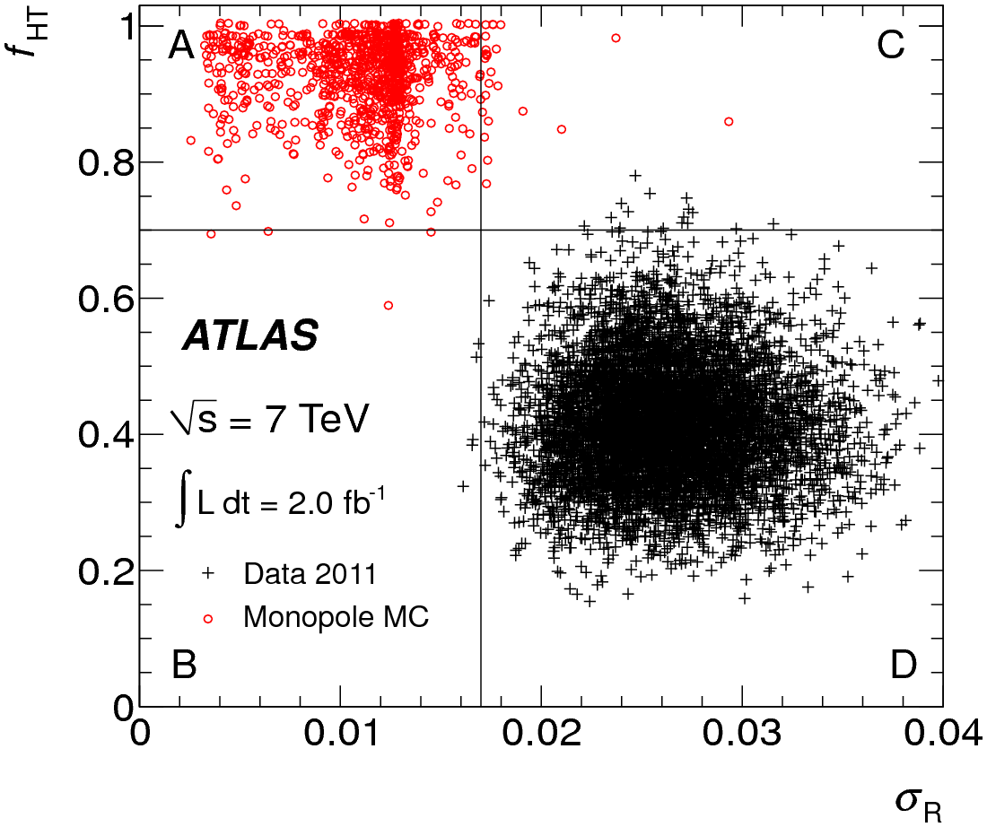
The ABCD Method
Requires two variables that are uncorrelated for the background.
  Signal can be and often is correlated.
  If the variables are not exactly uncorrelated, this becomes an approximation.
Requires that regions B,C and D all be dominated by the background
This doesn’t say anything about how much signal “leaks” into B and C
  Usually this is done with Monte Carlo
A general method (the above plot has nothing to do with the Higgs) to answer the question “how much background is inside signal region A”?

Slide 44
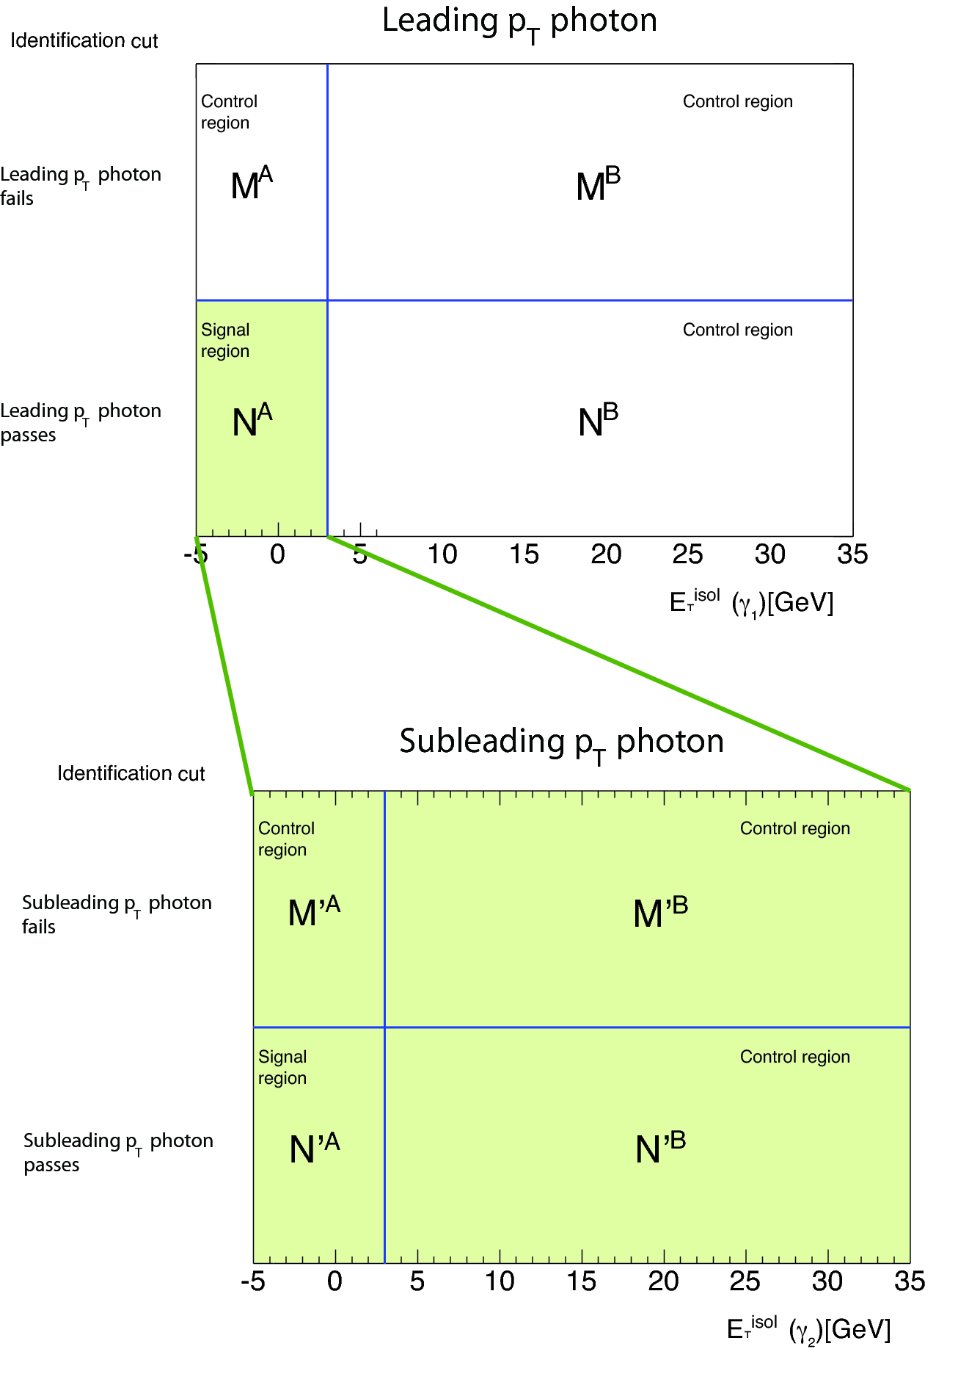
ABCD for Diphotons
Here the two uncorrelated variables are:
  Photon identification: the shower shape variables I discussed ~10 slides back plus the absence of a track pointing at the shower.
  Isolation: how much energy is around the photon. If the photon came from a jet, odds are that there is some remnant nearby that we can detect.
    Isolation energy is directly affected by pileup, so we want to make this area as small as possible.
We can apply this to both photons, so at the end of the process we know how many events have zero, one or two real photons.

Slide 45
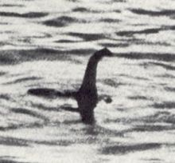
What Are We Searching For?
We cannot avoid this question any more.
  Are we looking for a generic particle that decays to γγ?
  Or are we looking for the SM Higgs?
This matters:
  Are we allowed to use Higgs production models in this analysis?
  What about assuming its spin-0? (Isotropic decays in any frame)
Both experiments have decided to design the search around the SM Higgs
  For exclusion, this is obviously the right thing to do
  For a search, we have decided matching the exclusion strategy was best

Slide 46
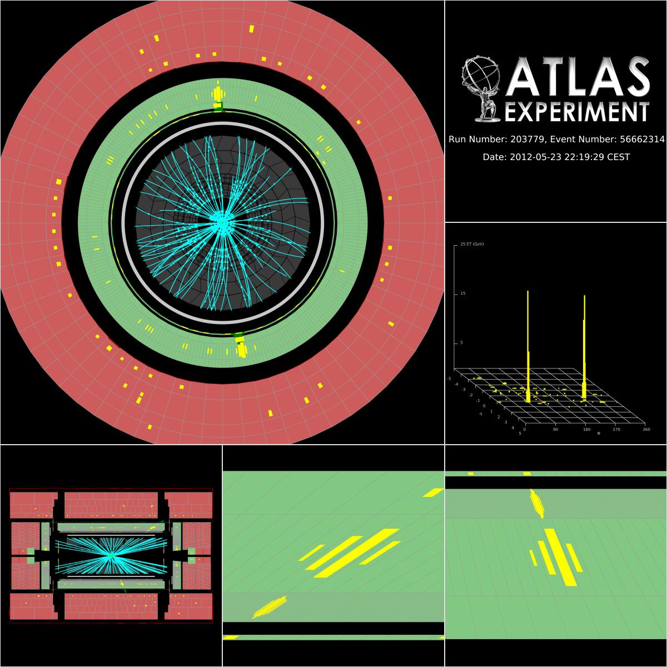
A Typical Pretty Two Photon Event
Photons are obvious, even with pile-up
  Note that low p_{T} tracks are suppressed in the display
One can see how the EM showers can be used to point back to the primary vertex
  Usually points to within ±1 interaction of the correct vertex
  This is as good as it needs to be; beyond this it’s diminishing returns
Three photon regions: central, endcap, transition
  The transition region is difficult

Slide 47
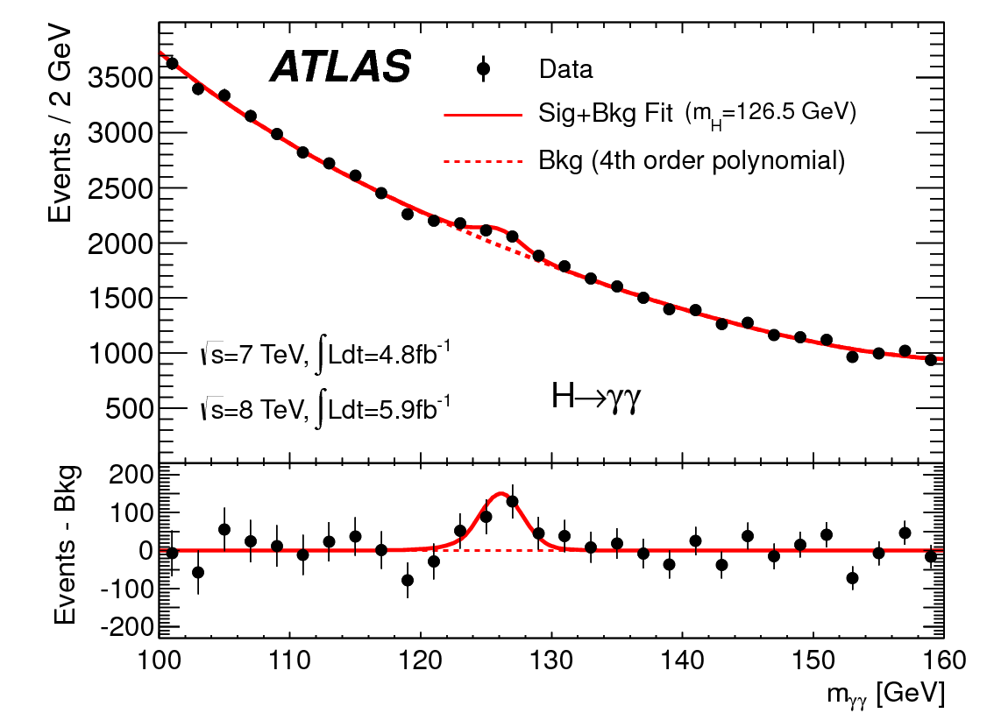
The Data
This plot, shown in many places, is actually not really used in the analysis.
Actually, we look at things in ten categories.

Slide 48
ATLAS γγ Categorization
Are there two jets?
No
Yes
Any conversions?
Yes
Both central?
No
In Transition Rgn?
Yes
No
No
Yes
Both central?
Categories 5&6
based on pTt
Category 9
“Transition”
No
Yes
Categories 7&8
based on pTt
Categories 1&2
based on pTt
Categories 3&4
based on pTt
Category 10
“VBF”

Slide 49
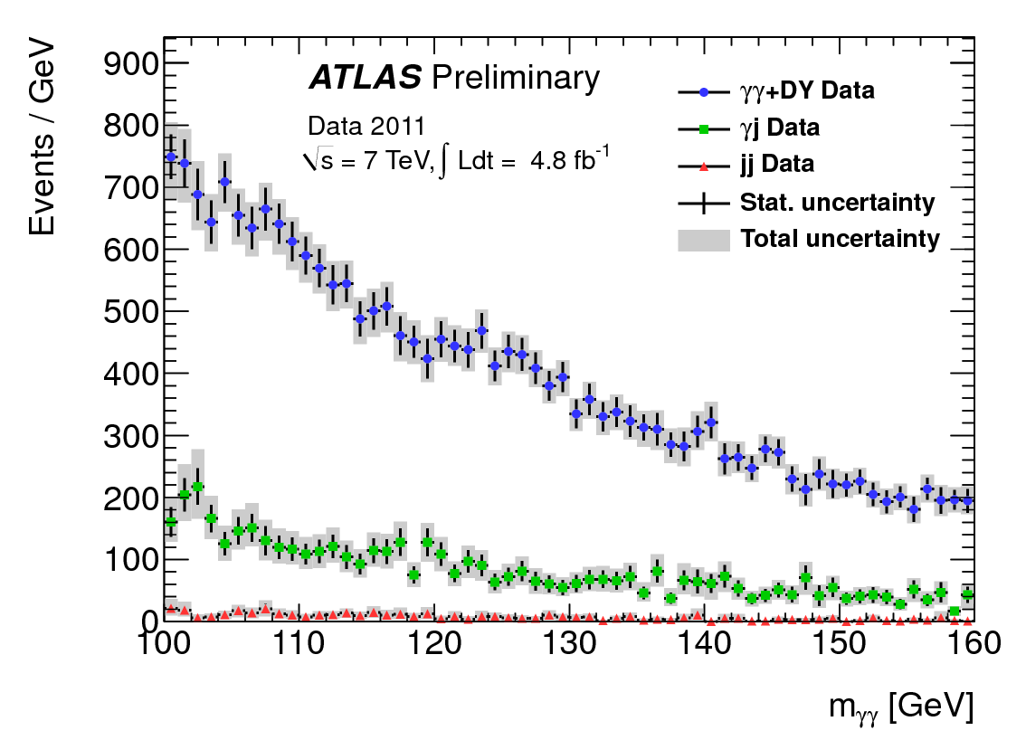
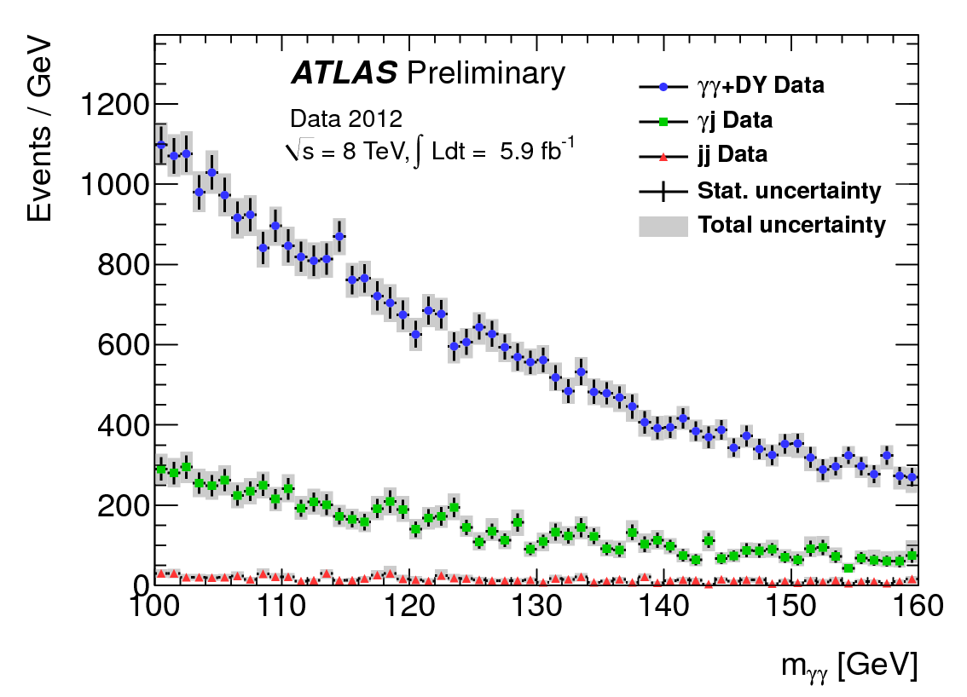
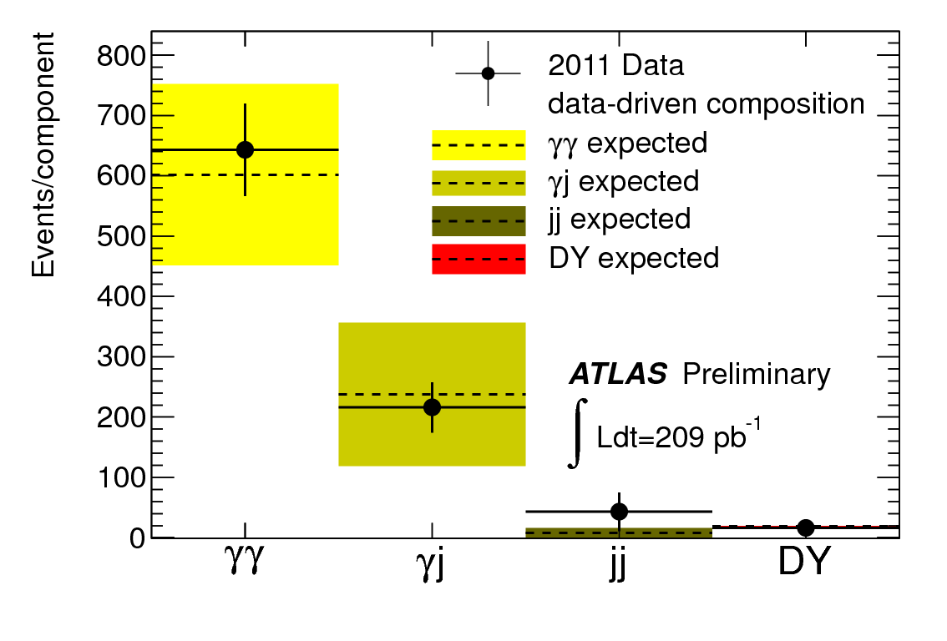
Diphoton Background
The background is mostly real diphotons.
  Improving fake photon rejection will help, but we’re past the point of diminishing returns.
The 7 TeV data and 8 TeV data look similar, but not identical.
  They can be combined, but they have to be handled separately. This is a royal pain in the wazoozy.
Although we don’t use the absolute QCD predictions anywhere in this analysis, this is about what we would have expected these plots to look like.

Slide 50
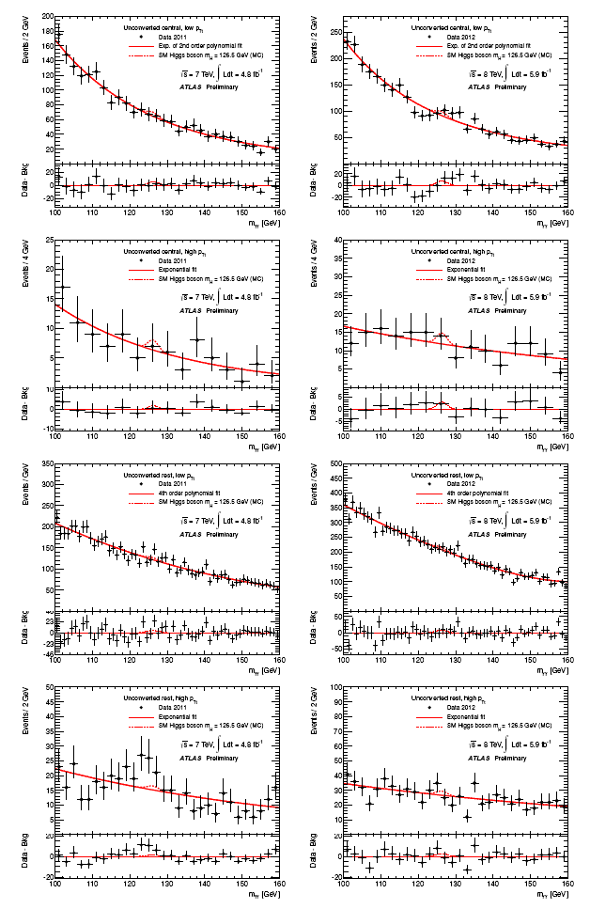
Results in Each Bin
1 | 1 | 5 | 5 | 9 | 9
2 | 2 | 6 | 6 | 10 | 10
3 | 3 | 7 | 7
4 | 4 | 8 | 8
7 TeV
8 TeV

Slide 51
Results in Each Bin
Obviously, none of the individual bins are significant by themselves
  This is what one expects for 20 bins (10 x 2 energies) and a ~4σ signal
You can think of the combination as a sort of MVA
  Because it is – this is an example of an (unboosted) Decision Tree
  The statistical test is asking the question “Is there an excess…and is this excess distributed in the way we expect for a SM Higgs?”
  We could have gotten the same total excess distributed differently – and this would have given us a different total significance
The fact we are looking for an SM Higgs rather than a generic particle decaying to γγ is built into this analysis.
  For example, the best fit yield for a fermiphobic Higgs would be different
  This technique adds a little less than 1σ to the significance for this data set.
1 | 1 | 5 | 5 | 9 | 9
2 | 2 | 6 | 6 | 10 | 10
3 | 3 | 7 | 7
4 | 4 | 8 | 8
7 TeV
8 TeV

Slide 52
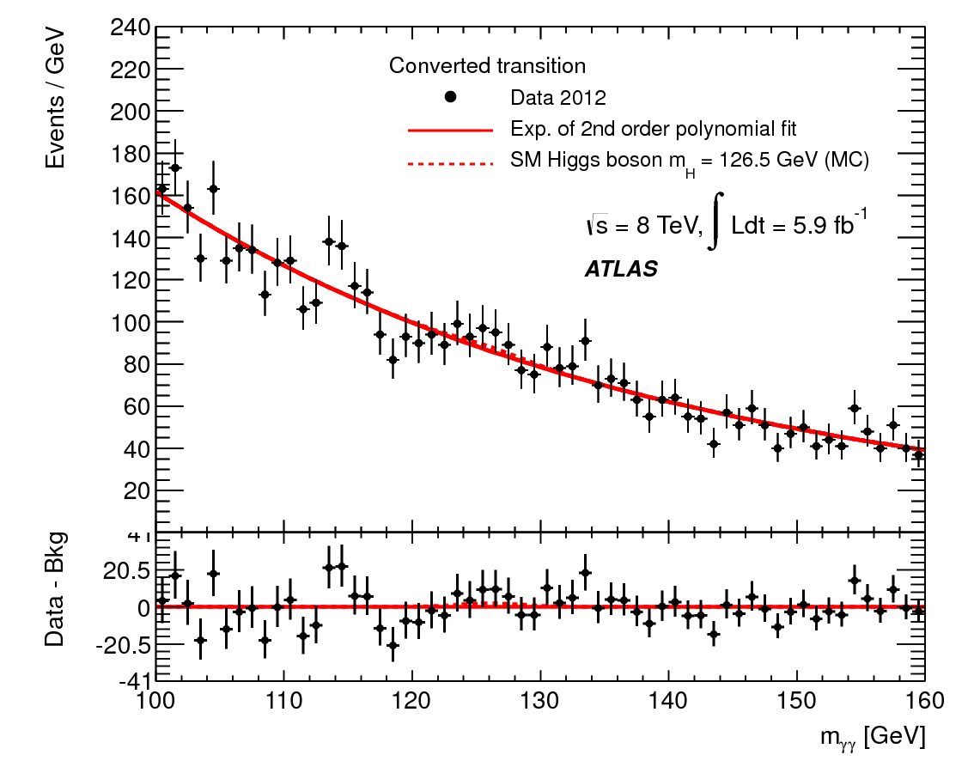
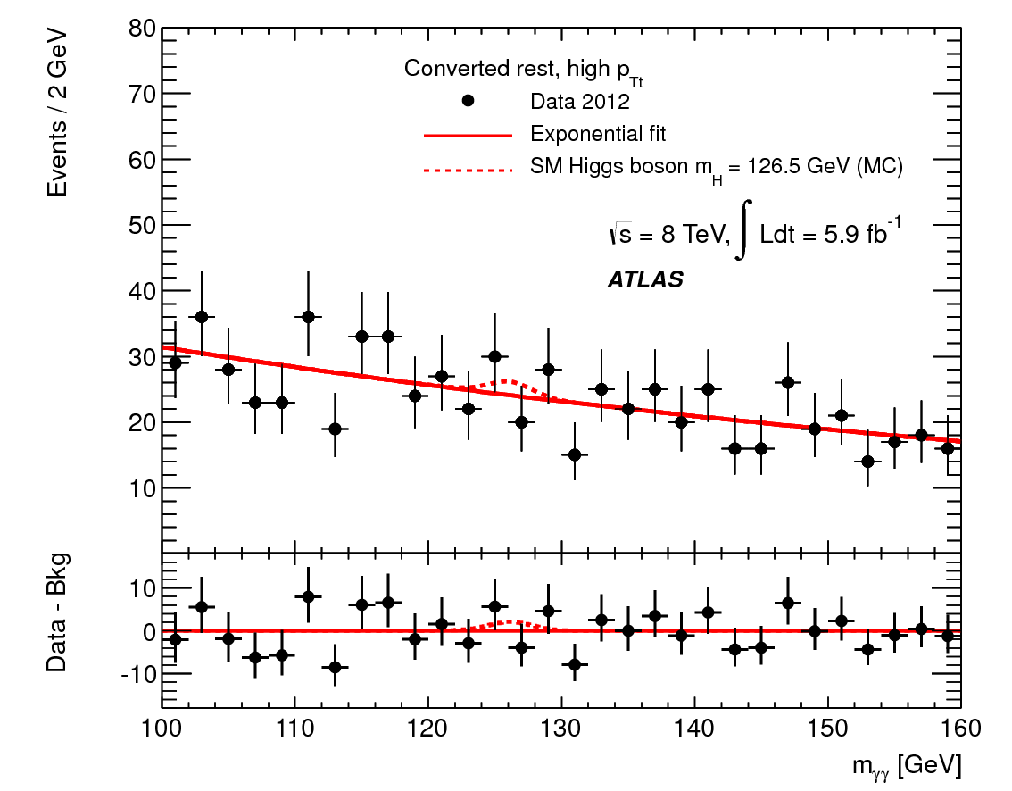
A Close-Up
10
9
These regions don’t look anything like each other
  Signal width
  Signal to noise ratio
  Background shape (still, it would be nice if the same functional form everywhere. <sigh>)
  Event yield
Why lump them together in the analysis?

Slide 53
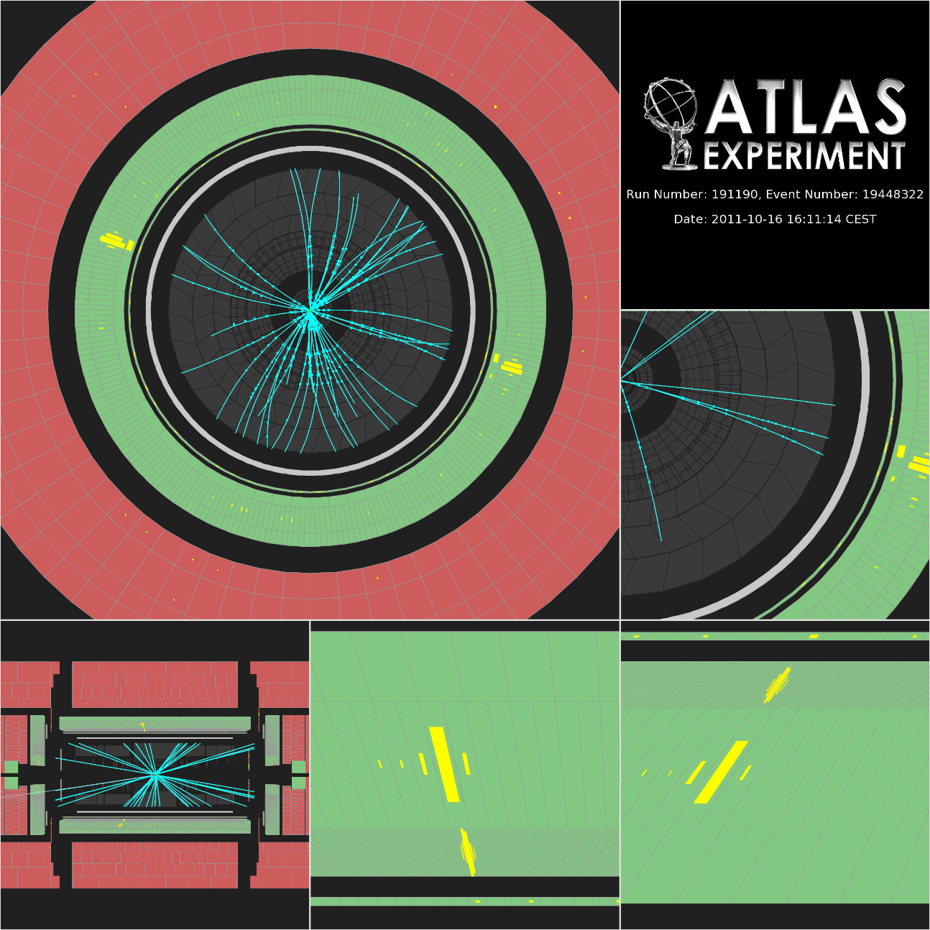
One Particular Event
This event has
  One central unconverted photon
  One central converted photon
  A low pTt (6.5 GeV)
This places it in Category 5

Slide 54
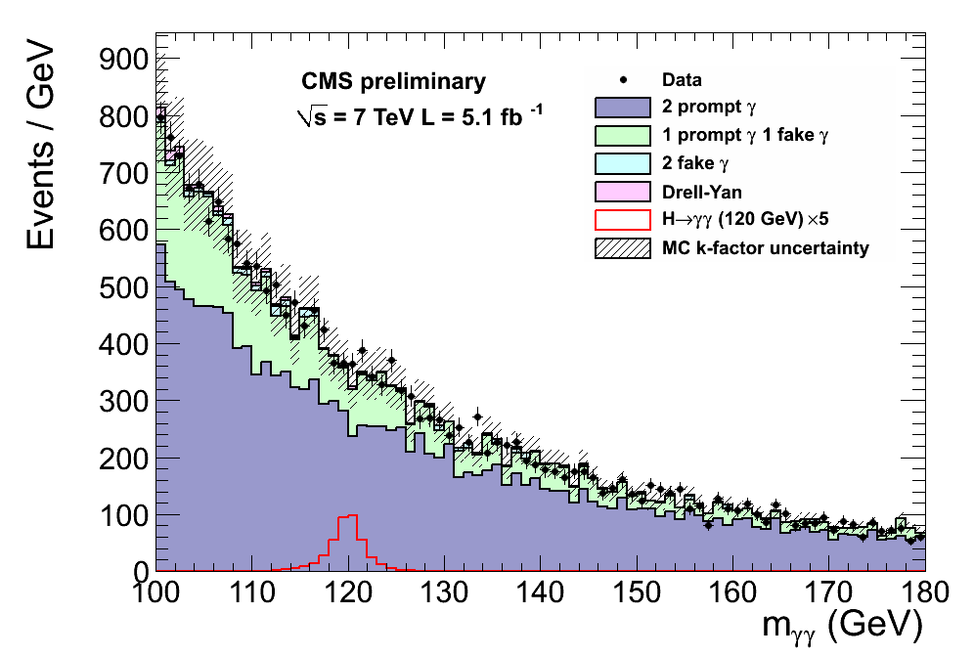
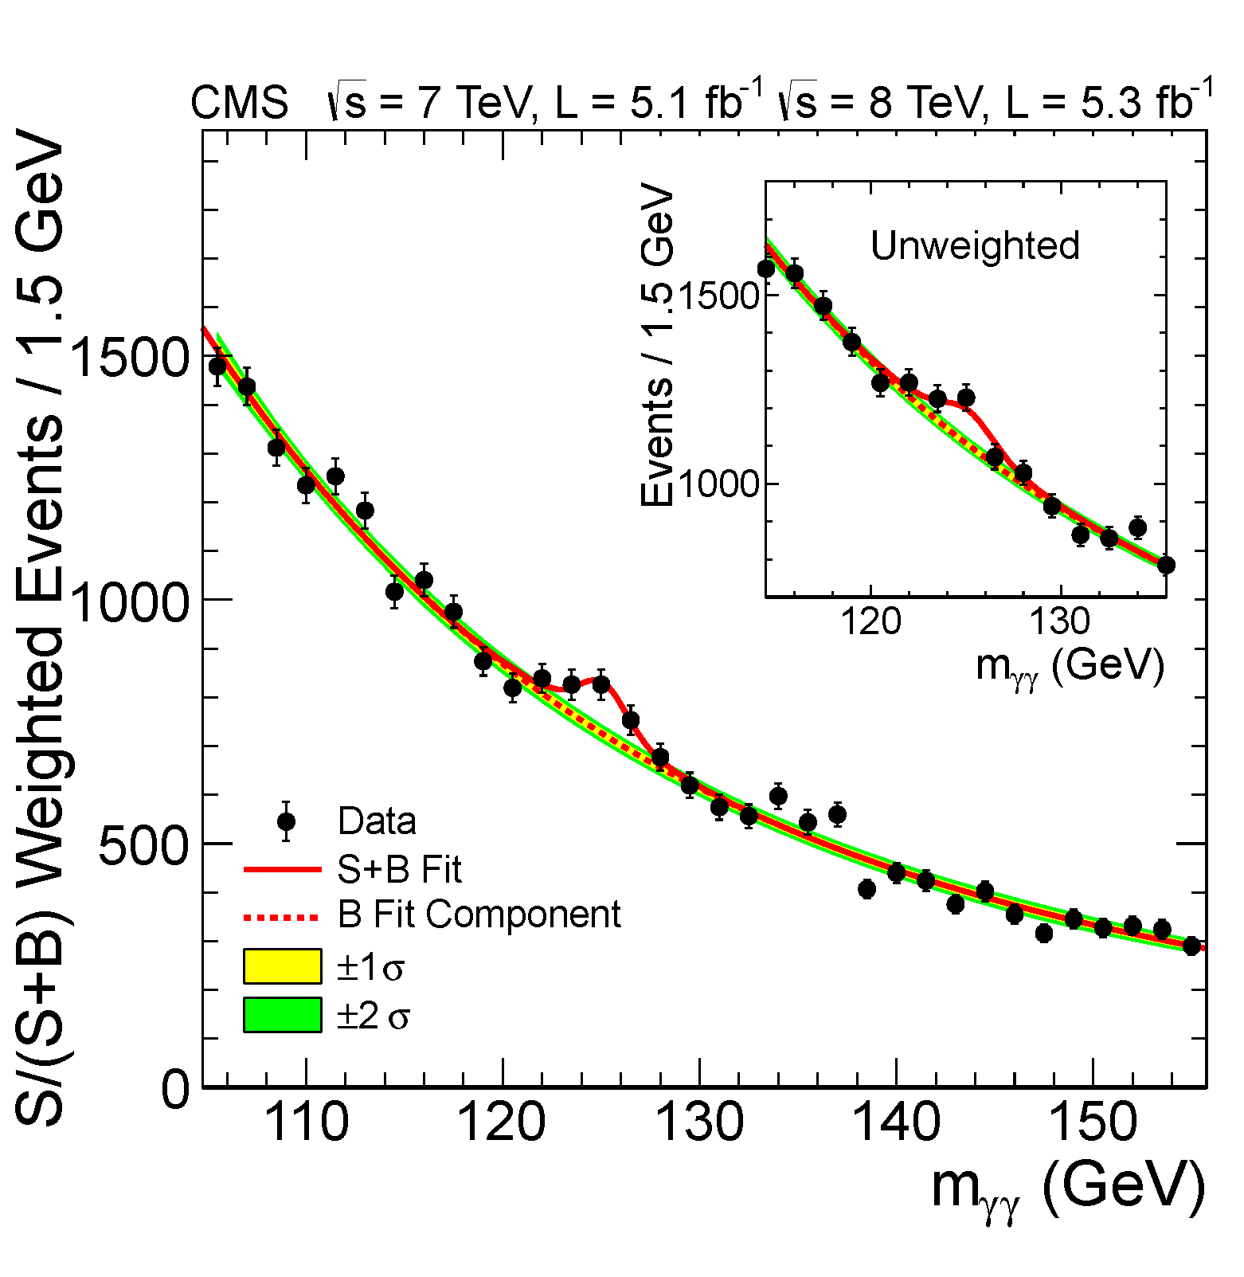
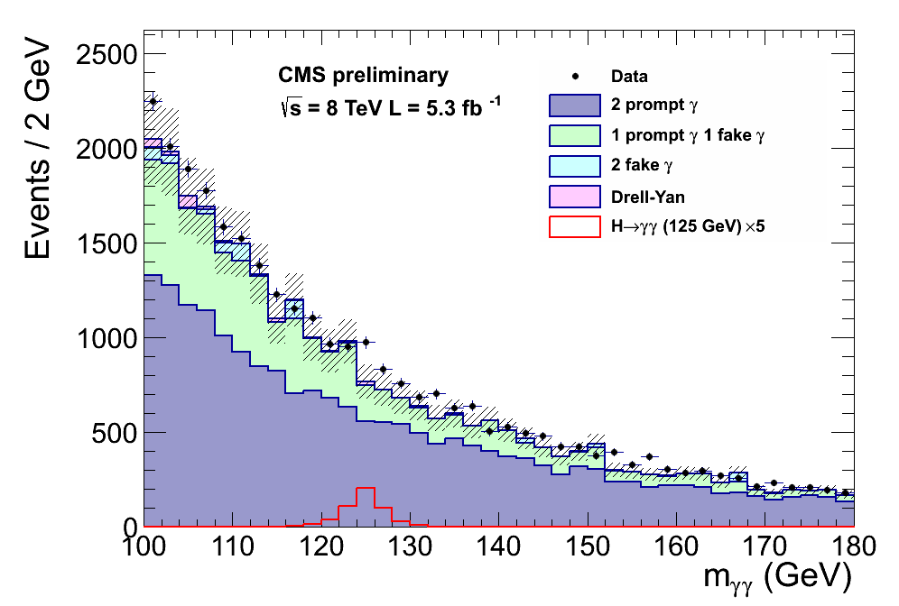
CMS Results
The background is ~75% real γ-γ events
  Ordinary QCD Production
  Very similar to ATLAS
This is why I am not going to describe the photon cuts in detail: separating photons from neutral mesons is not the biggest challenge in this measurement.

Slide 55
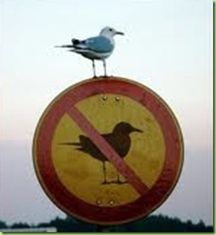
An Observation
The CMS calorimeter emphasized resolution – but at the
end of the day they got about the same resolution as ATLAS.
The ATLAS calorimeter emphasized background rejection – but
at the end of the day they got about the same signal-to-background as CMS.
I’m sure there’s a lesson in this somewhere.
Anyway, it’s time to move on

Slide 56
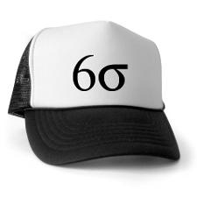
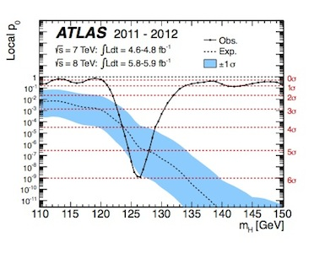
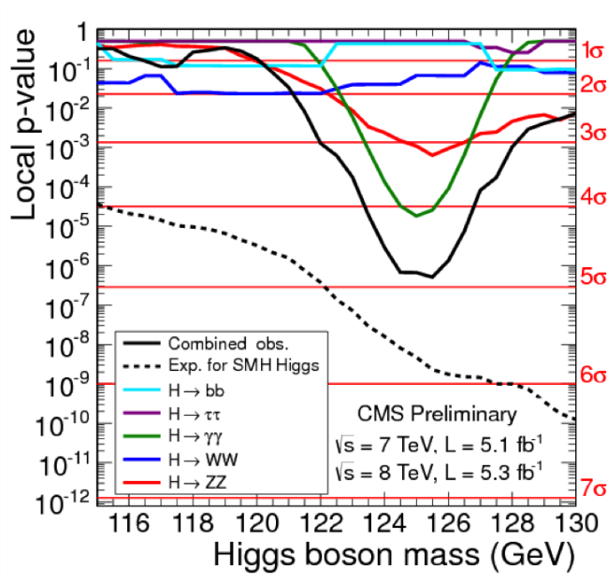
July 4th, 2012
The ATLAS and CMS experiments reported seeing a new particle
  At the same mass (~125 GeV)
  In two decay channels (γγ and ZZ*)
  With about the same production rate – the same rate as predicted for the SM Higgs
  With a combined statistical significance of > 6σ: p₀ < 1 in a billion
  With some minor supporting (at least not impeaching) evidence

Slide 57
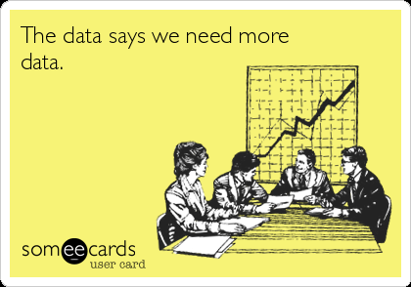
And, with more data…

Slide 58

H → γγ

Slide 59

H → ZZ*

Slide 60

An Immediate Fact and A Mystery
Fact: whatever the new particle was (we called it “Higgs-like” in those days), it coupled very strongly to the Z
  The rate of h → ZZ* was ~30x the rate of h → γγ.
    Even though the Z* must be off-shell by at least 56 GeV: about 25Γ!
    Higgs or not, one could not write down a correct theory of electroweak symmetry breaking without including this particle.
Mystery: why does it weigh 125 GeV?
  This makes no sense.
  At tree level, things are fine.
  When you impose quantum corrections, they push this mass way, way up – to the GUT or even the Planck scale…
  …unless you impose a symmetry
    For example, pair each upward correction with a downward one (SUSY does this)
    The problem is this mechanism usually works too well, and the Higgs becomes lighter than 125 GeV
  We don’t have a good answer to this

Slide 61
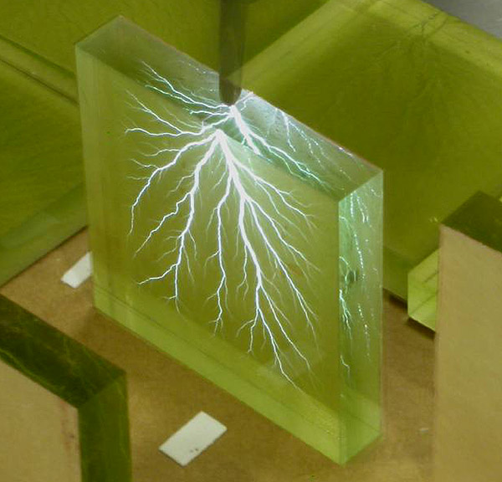
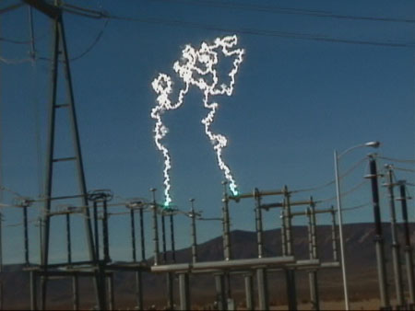
Getting a Beam of 7 TeV Protons
In principle, this is simple: put 7 trillion volts of potential on a proton and let ‘er rip…
This may not be the safest course of action – here is what less than one four-millionth of this potential can do:
500 kV in air
1600 kV in acrylic
Even in vacuum this won’t work – the electric fields necessary would rip the atoms apart.

Slide 62
How To Build a Linear Accelerator
RF standing wave inside these cavities
Proton enters cavity.
Electric field accelerates it to the right.
Proton continues.
Electric field decreases.
Electric field reverses sign. Proton enters a field free region and feels no force.
Proton enters the next cavity. Electric field accelerates it to the right.

Slide 63
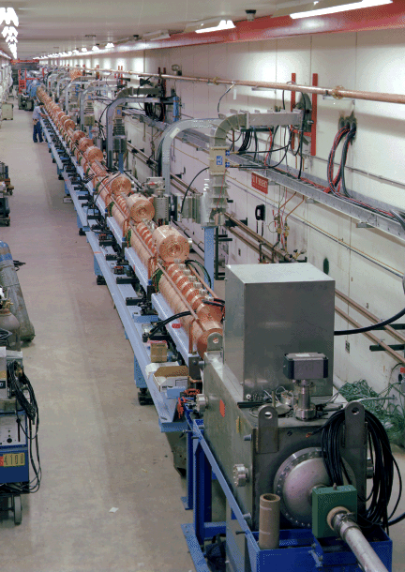
Linear Acceleration
In principle, our problem is solved: simply build a long enough linear accelerator
This isn’t too practical. Using state of the art cavities, reaching the LHC design energy of 7 TeV on 7 TeV means
  It would be 150 miles long
  It would cost $75 billion
A portion of Fermilab’s linear accelerator

Slide 64
Recycling: The Proton Synchrotron
Magnetic field in the particle’s path
Accelerating structures are reused ~20 million times during each fill of the LHC
The cost of such a machine is ~an order of magnitude cheaper than an equivalent linear accelerator
The energy that can be reached is limited by the strength of the magnetic field in the arcs
  These are dipole magnets
  Field direction is into the page
  LHC dipole fields are 8.36 T
r = 4.2 km
And returns here
Beam exits here
Linear accelerator
LHC, at CERN

Slide 65
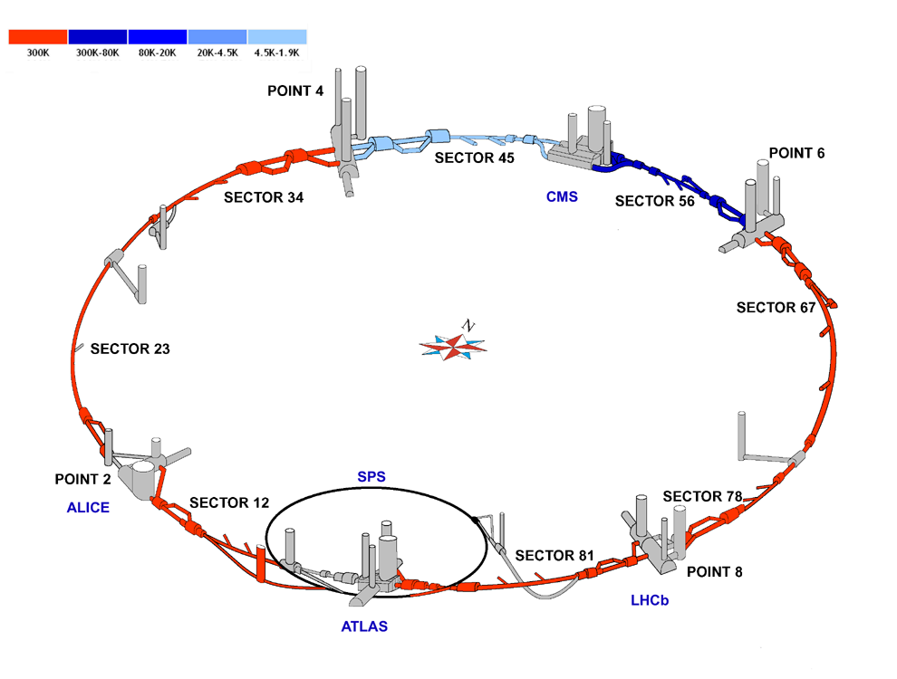
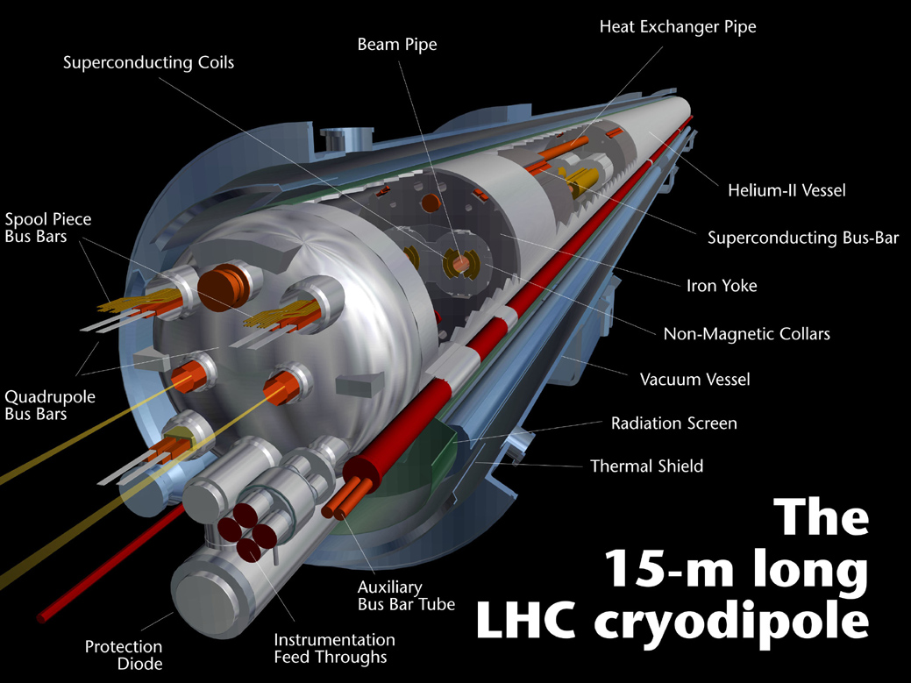
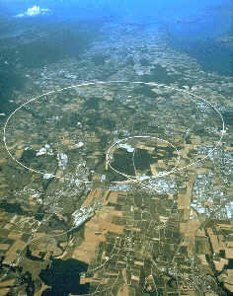
A Less Cartoonish View
The Large Hadron Collider is a 26km long circular accelerator built at CERN, near Geneva Switzerland.
The magnetic field is created by 1232 dipole magnets (plus thousands of focusing and correction magnets) arranged in a ring in the tunnel.

Slide 66
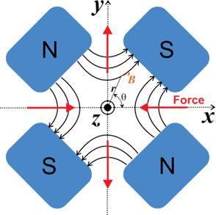
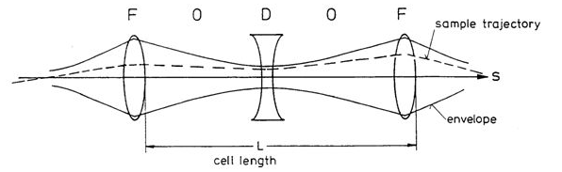

Keeping the Beam from Exploding
A beam has particles all with the same charge – how do we keep them together?
Transverse to the beam,
we use quadrupole magnets
A quadrupole in one orientation focuses horizontally and defocuses vertically. The other orientation does the reverse.
From optics*: a combination of focusing and
defocusing is net focusing.
Longitudinal to the beam, we use RF, the same RF we used for acceleration.
Together this gives us stability in x, y and z.
* Homework: what is the relationship between f and L that makes this true?

Slide 67

Our Next Problem - Resistance
26 km of electromagnets
To generate the field we want, we need to carry about 12000 Amperes.
US NFPA code says one needs a “wire” that has a diameter of about 35 cm to safely carry this current.
  This is 000…000 (32 zeros) gauge “wire”
    In practice one would use a shaped piece of copper.
    It’s probably impossible to control the shape of the current flow accurately enough
Resistance is only 0.02 Ω
  This means Joule heating is 3 megawatts
LHC Circuit Diagram
Need to go to superconducting magnets.

Slide 68




Using Superconducting Magnets
Zero resistance – a good thing!
Field is limited to ~9 Tesla (see next slide)
They have to be kept cold: around 1.9K
  Carnot efficiency of pumping out any heat that’s leaked in is 1.9K/300K < 1%.
  This is less than 15W per magnet
  for superconducting magnets to “win”

Slide 69
Superconductivity Facts
T
Superconductivity can be destroyed by:
  Shaking apart the Cooper pairs (exceeding T_{c})
  Pulling apart the Cooper pairs
  (exceeding H_{c} or j_{c})
Because we want to run at high fields/high currents we want a cold magnet
  T = 1.9K
  T_{c} for Ni-Ti is 17.9K
At 1.9K the small sample limit is ~9T
  At design LHC magnets operate at 8.36T
H
j
Phase diagram for a superconductor
Think “critical surface” instead of “critical temperature”

Slide 70



Superconducting “Wire”
Nb-Ti has great superconducting properties
  High T_{c}, H_{c} and j_{c}.
It has the mechanical consistency of toothpaste.
It’s surrounded by a thin (~ 10% of the radius) copper jacket
  Provides mechanical strength
  Carries most (~80%) of the current when the magnet is warm
    Copper area is 20% of the area of the cable, but copper’s resistivity is 40x smaller.

Slide 71

Colliders Two:
Tom LeCompte
High Energy Physics Division
Argonne National Laboratory

Slide 72

A Question Over Lunch
“Can you describe the role of Monte Carlo in the Higgs search?”
The Higgs search in the discovery era was designed to use as little Monte Carlo as possible.
Plots like this have the background fit
from the data, not Monte Carlo.

Slide 73


Collider Physics On One Slide
We collide particles together and measure the energies and trajectories of the products in our detectors
We then compare these results with simulation – at multiple levels
  Does the detector respond to these particles in the way we expect?
  Do we see the number of particles in various categories that we expect?
  Etc.
This is a complex process, and we are as dependent on the simulation chain as we are on the data chain.
  ATLAS uses about a billion cpu-hours per year on this.

Slide 74

How It Works
Real Data Chain
Simulated Data Chain
Simulates the physics process of interest: produces lists of particles and their momenta
Event Generation
Simulates the interaction of these particles with the detector
Simulation
Infers particles that must have been present based on the detector response
Reconstruction
Reconstruction
Analysis: comparing the two

Slide 75
Computing to Reach The Science Goals
ATLAS uses about a billion CPU-hours per year on the Grid
  This does not include the cycles spent calibrating or reconstructing the data; the problem is defined as what happens after this point
“The Grid” is the Worldwide LHC Computing Grid
  140,000 Xeon-class cores
    Distributed in ~100 farms
  2 GB each
  Jobs are single-core
  (~12 hours)
Event Generation
Simulation
Reconstruction and Analysis

Slide 76
Event Generation Example: Alpgen
Alpgen: “a generator for hard multiparton processes in hadronic collisions”
  An event generator (see http://mlm.web.cern.ch/mlm/alpgen/)
    Simulates the physics process of interest
    Produces lists of particles and their momenta
Written in FORTRAN77 (with optional F90 part)
  About 250K lines of code
Makes up ~5% of ATLAS Grid computing
  Hoped to move 40% of this to supercomputers: 2% is big enough to be interesting, but small enough that the experiment will not collapse if we failed.

Slide 77

Supercomputing and Monte Carlo
Mira is a supercomputer at ANL (#17 in the world in 2018)
  ¾ of a million processors
  Combined computational power of all the cell phones in Toronto
Based on this success, the experiment asked us to do all the Alpgen gheneration for the next two years
While this job was running, Mira was producing the equivalent computing as 5 or 6 ATLAS Grids.
On our best days, we provide the equivalent computing capacity of the whole ATLAS Grid.

Slide 78
Phase-space integrals
You can have each rank work on part of the problem, and sum them later. Equal spacing means some ranks finish sooner than others.
You can better balance things with unequal spacing, trying to match areas. There is a limit to this – if you knew the areas exactly, you wouldn’t need to do the integral.

Slide 79
Simulation/Digitization
Simulates the interaction of these particles with the detector
This is the green part of the diagram
  Once ~70% of the usage
  Falling to 60% or even less – but only because the red (generation)
  has grown
This uses a C++ toolkit called Geant4
  http://geant4.cern.ch/
  About 1 million lines of code
  The only program HEP uses for this
    Modular, so different models can be inserted in the same framework
  Identifies the position and amount of energy deposits in the detector
    Energy is all that matters

Slide 80




Geant4 goes beyond HEP
Electron avalanches in thunderstorms
Radiation effects on satellites
Dose calculations in proton therapy
Improved PET scanning development

Slide 81
How It Works
1
2
3
Material 1
Material 2
The program takes small steps with each particle through the detector. At each step, one of three things can happen:
  1. The particle deposits some energy via ionization, and takes another step
  2. A new particle is created, and added to the list of particles
  3. The particle is absorbed, stopped, or exits the detector and removed from the list
Geant starts with the particles produced in the collision and continues until the particle list is empty
This takes a few minutes per event (for a typical ATLAS event)

Slide 82


Hadronic Showers
Muon

Slide 83

Aside: How I Got Into Supercomputing
When I came back after being ATLAS physics coordinator, I was looking for some physics to do.
Steve Martin (NIU) and I asked ourselves about the sensitivity of the LHC experiments to moderately compressed SUSY spectra
  Answer: better than you might think (c.f. PRD84 015004 and PRD85 035023)
ATLAS did the study, and here’s the outcome (as shown in the 7 TeV paper):
The observed limit is better than our expected limit. We (perhaps foolishly) did not run any points out there.
This set of points spent ~2 months in the queue waiting for open slots.
We decided not to delay this paper by another ~2 months
The problem
We didn’t simulate these points, so we have no idea what the limits are here.

Slide 84

High Performance Computing Motivation in HEP
There are two problems we are trying to solve
The capacity problem
  Our needs are growing faster than the Grid is growing – and likely can grow
The capability problem
  Some problems can’t run on the Grid
    Highly filtered samples can produce zero events in a job – which looks like a failure and triggers a resubmit. Which triggers a resubmit. And so on.
    Sherpa integration times
    stretch into the weeks, but can be done overnight with a few hundred threads
    (scaling is poor today, but this makes doing this possible. Efficient comes later)
The green assumes 15% growth per year from Run 1, and
that Run 1 had exactly enough capacity.
We see HPCs playing a role in both of these

Slide 85

Events Like These:
This is a Z (→ ττ) + 5 jet event, with highly filtered τ decays.
ATLAS requested that we make them, because they failed on the Grid
  The degree of filtering is so high, runs often have zero events pass – misinterpreted as a failure. This is not a problem with thousands of cores.
There are another 46,998 events just like this one.

Slide 86

What NOT to Do With Your Magnet
Suppose a small region in your superconducting cable goes normal.
Current will flow around the resistive spot, driving it past j_{c}; the spot grows
Eventually, the entire cross-section goes normal, and now you have a resistive wire. All the heat is dissipated in that spot.
Stored energy in magnets = 10 GJ, same as a 747 at top speed.)
A magnet undergoing a controlled quench.

Slide 87
2008 “Incident” Timeline
March 2008 – CERN announces the LHC will start with 5 TeV per beam rather than 7 TeV. This avoids a lengthy magnet retaining process.
10 September 2008 – amidst much media hoopla, beams are circulated at 450 GeV (injection energy). At this time, 7 of the 8 sectors are “qualified for 10 TeV collisions”, meaning they operate properly at 11 TeV equivalent current.
18 September 2008 – a transformer near Point 5 fails. EDF says it will take a couple of days to find and install a replacement. Two sectors start to warm. Decided to return to qualifying the last sector, 3-4, in parallel.
19 September 2008 – during one of these tests, a magnet quench led to an electrical arc, which in turn led to a catastrophic loss of helium, which made a great big mess.

Slide 88


Aftermath
A one-year delay
  53 magnets had to be removed and repaired or replaced
  Quench protection system redesigned and replaced
  Additional vents were added to most of the dipoles
Beam energy lowered to 3.5 TeV per beam in 2011
  This is 4x safer (P=I²R)
  This also allows for a lower dump resistance and faster dump – reduced risk.
  However, the physics reach is less (by 5-10), but still far beyond what we had before.
  Energies 4.0 TeV in 2012, 6.5 TeV in 2015

Slide 89
Why Build A Collider Anyway?
Before colliders, we had fixed-target experiments
Beam hit a target, reaction products go forward where they are studied.
The more energetic the beam, the more momentum it carries
The more momentum it carries, the more the reaction products go forward
To look for new particles and new phenomena, you want the center of mass energy (a Lorentz-invariant quantity) as high as you can get it
Increasing the beam energy causes the center of mass energy to grow only as the square root
If instead we collide the beams, we can
work in the center of mass frame
The price we pay? Luminosity.

Slide 90

Luminosity
$$L=N_{b}f\frac{N_{1}N_{2}}{4πσ_{x}σ_{y}}=N_{b}f\frac{N_{1}N_{2}}{4πεβ}$$
Elements of the Equation
  N_{b} is the number of bunches in the ring
  f is the frequency of revolution
  N₁ and N₂ are the number of particles in each bunch
  The denominator is the area of the beam
    I can express it in lengths (σ)
    But it’s more useful to express it in terms of emittance (ε), a property of the beam itself
    and β, a property of the accelerator FODO lattice
      For simplicity, I made the beam circular in the 2nd equation
    We call β at the interaction region β*.
Luminosity has the rather odd-looking units of inverse area per unit time
  Why will become clear soon
These are, of course, correlated

Slide 91

Getting Higher Luminosity
$$L=N_{b}f\frac{N_{1}N_{2}}{4πεβ}$$
What elements do we have control over?
  N_{b} is the number of bunches in the ring – fixed once you know the RF
    A bit of a lie, because not every bucket is filled, e.g. the Tevatron had 1113 buckets but only 36 filled. For the LHC those numbers are 35640 and 2808 (at design).
  f is the frequency of revolution – again fixed once you know the RF
  N₁ and N₂ are limited by electrostatic repulsion of the beam
    For the Tevatron N₂ was determined by the antiproton production rate
  The emittance is a function of the beam quality in the injector chain
    Small is good, but…
    More beam usually means higher emittance
  Lowering β* is good, but remember quadupoles are lenses
    The smaller I make the beam at the interaction point,
    the larger I make it everywhere else. There are limits.

Slide 92


The Proton
A proton is a very dynamic thing composed of interacting antiquarks, quarks (3 more than the antiquarks, and gluons.
At LHC energies, γ = almost 7000
  This Lorentz contracts the proton into a thin disk
    Aspect ratio about the same as a sheet of paper
  Time dilation “freezes” the proton so it appears static
A 4-dimensional object becomes a 2-dimensional object

Slide 93
More on Luminosity
Consider two colliding beams of flat disks
The interaction rate is proportional to the fluxes, and also to the area of the disks.
Rate = Luminosity x Cross-Section(al Area)
  Luminosity has dimensions of inverse area per time
  Cross-section is proportional to probability

Slide 94

Cross-section, Luminosity and Units
(by example)
A square meter is too big to be practical
Instead we use a conventional unit called a “barn” = 10⁻²⁸ m²
  From the expression “broad side of a barn”
  This is still too big to be practical, so we usually talk about millibarns, microbarns, nanobarns, picobarns, etc.
Example: the top quark cross section at 7 TeV is 175 pb.
  Easy to remember, since the mass is 175 GeV.
  Since the proton total inelastic cross section at 7 TeV is 100 mb…
  The probability of producing a top quark is (175 pb)/(100 mb) = 1.75 x 10⁻⁹
A luminosity of 10³³ cm⁻² s⁻¹ works out to 1 nb⁻¹/s
  1 nb⁻¹ second x 100 mb = interaction rate of 100 MHz
  1 nb⁻¹ second x 175 pb = top quark rate of 6/minute

Slide 95


The Frozen Proton
Because the proton is frozen in time, we can envision each parton as carrying a fraction x (sometimes called Bjorken x) of the proton’s total momentum
We talk about the proton-(anti) proton center of mass energy, but what’s really relevant is the parton-parton center of mass energy, which is
  Variable
  Smaller (around 20% the energy)

Slide 96

Onto Experiment Design…

Slide 97


Fact One: The basic design of experiments is the same:
Tracking
Calorimeters
Muon detectors
Driven by the physics of the interaction of high energy particles with matter.
Because the physics is the same, successful experimental designs are similar

Slide 98
The Compact Muon Solenoid

Slide 99

CMS Under Construction

Slide 100

CMS Today

Slide 101
ATLAS = A Toroidal LHC ApparatuS

Slide 102

ATLAS Under Construction

Slide 103

ATLAS Today

Slide 104


Fact Two: Tracking measures 1/p
Charged particles in a uniform magnetic
field move in helices:
It’s convenient to work in the transverse plane (i.e. the plane normal to the Z direction)
In this plane, the helices project to circles.

Slide 105
Fact Two: Tracking measures 1/p (II)
The sagitta (“arrow”) s is the distance of maximum deflection from a straight line track:
Radial line from origin to point where the particle exits the tracker:
or
Which leads to the expression
As momentum increases, tracking becomes more difficult.

Slide 106


How To Spot A Particle
Really only one idea – as a particle traverses material, it ionizes that material
Two common material choices
  Silicon
    Read out directly
  Noble gasses, often with something flammable added to make things more interesting (e.g. Argon + Ethane)
    Read out via wires or pads

Slide 107


Silicon vs. Gas
Silicon
  Pros
    Excellent resolution (few micron-level)
  Cons
    Heavy – low momentum particles multiple scatter
    Expensive (not the sensors so much as the readout electronics)
    Hot – sophisticated cooling required
Gas
  Pros
    Low multiple scattering
    Relatively inexpensive
  Cons
    Moderate resolution (10’s-100’s of microns)
    Flammable (to avoid this, people use Ar-CO2 instead of Ar-Ethane)

Slide 108
Fact Three: Sampling Calorimeters
Absorber layers
A (constant) fraction of the incoming particle’s energy gets converted to something that we can count (photons, electrons, etc…)
In the approximation that each layer absorbs a constant fraction of the energy, the calorimeter depth grows logarithmically with energy.
Sensitive layers
As energy increases, calorimetry resolution improves.

Slide 109
Fact Three: Sampling Calorimeters (II)
Remember…
EM showers all look the same
Hadronic showers are like snowflakes
  Every one is unique
A schematic of an electromagnetic shower
A GEANT simulation of an electromagnetic shower

Slide 110

Total Absorption Calorimeters
Some calorimeters are homogeneous,
i.e. they don’t have separate absorber
and sampler layers
They convert the energy deposited into
light, by either
  Scintillation
  Cerenkov radiation
Either way, it’s still a statistical process
so there is still √E behavior
In general
  These have better resolution
  These are more expensive
  Radiation damage can be an issue
Block from OPAL. Uses Cerenkov radiation.

Slide 111

Fact Four: Compromise is a fact of life
Like it or not, experiments are constrained by resources
  Every dollar that goes into one subsystem is a dollar
  that doesn’t go into some other subsystem
  Every inch that goes into one subsystem is an inch
  that doesn’t go into some other subsystem
  A collaboration with N members can’t design an
  experiment that takes 2N members to build or operate.
  Industrial production capacity is finite
    Evidence: crystals, silicon wafers, liquid noble gasses
Most experimenters have their own ideas on the best optimization
  Individual interests and experience varies
  The goal of a collaboration is to design a detector that everyone can live with – even if no single person thinks it’s ideal.

Slide 112

Muon Detection:
The Iron Ball

Slide 113
What Is The Iron Ball?
Suppose you wanted a detector to look for a very heavy (800 GeV) Higgs via the decay H → ZZ followed by Z → μμ (both Z’s)
  This is a very rare process → increase the luminosity
  Handle this increased luminosity by only looking at muons:
B-field region

Slide 114


CMS Muon Detectors
CMS uses the return field of their central solenoid to measure muon momenta
Four planes of detector stations inside the steel measure the muon’s tracks.
Low p_{T} muons range out in the steel, providing an additional measurement.

Slide 115


The ATLAS Muon Spectrometer
How muon trajectories bend in the magnetic field of the toroids.
Energy stored in the magnetic field is ~1.2 GJ.
Energy stored in a lightning bolt is ~1.5 GJ.
Beam’s eye view
Pictures from Jim Shank, Boston University

Slide 116
Comparing Design Philosophies
Emphasizes
CMS uses as their magnetic field the return field through the iron
  Allows one to go to large fields…
  …which means small radii… (Figure of merit is BL²)
  …which means that their calorimeter can be small (and expensive per unit volume).
ATLAS uses air core toroids
  Very good resolution at high momentum
    Up to ~TeV scale muons
  Requires a lot of space
B
L²
Neither experiment is an iron ball, but elements of the iron ball design influenced both detectors.

Slide 117
Anticipated Muon Backgrounds
The main background to muons is other muons
What I mean is the main background to muons are muons from a source we are not particularly interested in.
  Example: pion or kaon decays
Improving purity beyond ATLAS or CMS hardly helps.
ATLAS
This is simulation – the equivalent plot for data exists, but is optimized to make a different point.

Slide 118

Unanticipated Muon Backgrounds
There is no such thing as a muon detector:
  They are charged particle detectors, behind lots of steel
  If there is any path around the steel, particles will find it
  Since there are a million hadrons per muon, even if this is unlikely, it can be an important background
At the LHC, the cavern backgrounds (secondary particles) might be large.
  The experiments have to worry about particles “raining down” into their detectors.
  This is VERY difficult to predict from first principles. It has to be measured. Fortunately, it turned out not to be a problem.
  This time.
The “CMX Ricochet”

Slide 119

Dimuon Mass
Requiring two muons is enough by itself to give a clean Z signal – and many other particles!
The background is real muons – just from other sources.

Slide 120

Colliders Three
Tom LeCompte
High Energy Physics Division
Argonne National Laboratory

Slide 121
Dimuon Mass
Requiring two muons is enough by itself to give a clean Z signal – and many other particles!
The background is real muons – just from other sources.

Slide 122
Why Does This Look So Weird?
The experiments have a trigger – a device that lets them select a fraction of events (around 10⁻⁵) to write out
It’s not enough to write out the events you are interested in
You also need to write out the events you need to understand the events you are interested in

Slide 123
Oversimplified Triggering In One Slide
Hardware-level triggering
  Uses a subset of the detectors with a short signal formation time
  Selects events quickly: needs to make a no/maybe decision for every bunch crossing
    This is 25 ns for the LHC
  However, it can take ~1 microsecond to make a decision. It does this via pipelining.
    For the LHC, 1 us means a pipeline 50 events deep
  Rejection factor: a few hundred to a few thousand
Software-level triggering
  Runs on large clusters of near-commodity computers
  Can run anything from fast algorithms to full reconstruction
  Only analyzes the fraction of events passed by the Hardware Level, but can analyze the entire event
  Rejection factor: also a few hundred to a few thousand (total is ~100,000)

Slide 124

Photon Detection Review

Slide 125
ATLAS Electromagnetic Calorimeter
Design resolution:
Technology: uses lead as an absorber and liquid argon as an ionization medium. Energy deposited in the calorimeter is converted to an electrical signal.

Slide 126
CMS Calorimeter Crystals
16X₀
CMS uses Lead Tungstate crystals
  Scintillator: energy is converted to light
  Exceptional energy resolution, because there are no inert absorbers
The focus is to get the best possible energy resolution, no matter what it takes
  Energy resolution is ~2x better than ATLAS’ in the region where Higgs decay is important
22X₀
26X₀
Design resolution:
Another nice feature – low noise
Photo: Ren-yuan Zhu, Caltech

Slide 127
CMS EM Calorimeter
Figure: Ren-yuan Zhu, Caltech

Slide 128
Comparing Design Philosophies
CMS emphasizes energy resolution
  Use PWO crystals
    Expensive – means go to small radius to keep the detector within budget
    Only handful of vendors worldwide
ATLAS emphasizes background rejection
  Able to go to larger radius: separates showers better
  Highly segmented calorimeter allows measurement of shower development
    One photon? Two? A hadron masquerading as a photon?
Both calorimeters are quite thick
  Improves resolution (showers are contained)
  Degrades electron-hadron separation
    ATLAS measurement of shower development is intended to compensate

Slide 129

Jets
When you’re a jet, you’re a jet all the way…
S. Sondheim

Slide 130


A Two Slide Review of Jets
A “blast” of particles, all going in roughly the same direction.
2 jets
2 jets
2
2
3 jets
5 jets
3
5
Calorimeter View
Same Events, Tracking View

Slide 131
We Can’t Pluck a Quark Out of A Proton
Where do jets come from?
The force between two colored objects (e.g. quarks) is roughly independent of distance
  Therefore the potential energy grows linearly with distance
  When it gets big enough, it pops a quark-antiquark pair out of the vacuum
  These quarks and antiquarks ultimately end up as a collection of hadrons
    Process is called “fragmentation” or “hadronization”
and try to pull a quark out,
If I take a particle,
The “string” holding the particle together breaks, and I produce more (usually many more) particles.

Slide 132
The Utility of Jets
What appears to be a highly inelastic process: two protons produce two jets of other particles… (plus two remnants that go down the beam pipe)
… is actually the elastic scattering of two constituents of the protons.
Jets are the best window we have into what the quarks are doing. Things that look very complicated when discussing individual particles simplify when talking about jets.

Slide 133

Measuring Jets
Lego plot of a simulated top quark event has EM calorimeter energy in green and hadronic calorimeter energy in red.
The prevalence of green comes from two facts:
  Half of the particles (and ~40% of the energy) in a jet are photons from neutral meson decay
  The LHC EM calorimeters are thick, and many hadrons begin their showers inside the electromagnetic calorimeters.
ATLAS

Slide 134



ATLAS “Tile” Hadronic Calorimeter
Uses steel as an absorber, and scintillating tiles as the active medium. Energy is converted to light.

Slide 135

CMS HCAL (Hadronic Calorimeter)
Also a scintillating tile-based sampling calorimeter
Technology is similar to ATLAS:
  Absorber is brass instead of steel
  Tile orientation is different (more conventional in CMS)
Calorimeter is relatively thin

Slide 136
Comparing Design Philosophies
CMS’ calorimeter is inside their magnet
  Additional depth is very expensive (since it requires a larger radius magnet)
  To increase the effective thickness, it’s made of a denser material (brass)
  ATLAS is quite thick – the outer muon detector resembles the “iron ball” design.
ATLAS would “naturally” use liquid argon for both the hadronic and electromagnetic calorimeter
  Both D0 and H1 designed their detectors this way
  This is also very expensive
Both experiments have chosen to economize here
  Slightly better performance would cost a lot more money

Slide 137

Jets & Hadron Calorimetry
Many things besides hadronic calorimeter response affect the jet energy determination: the EM calorimeter response, out of cone corrections, dead material and dead material corrections, hadronic decays or interactions upstream of the calorimeter…
Event with the best calorimeters, you are taking a very clear picture of a very fuzzy object. Economizing on the hadron calorimeter is often the “least bad” option.

Slide 138

Electrons & Other Tracks
CMS Silicon Detector
The figure of merit for momentum measurement is BL². A half dozen layers of silicon close in has great impact parameter resolution – but L is tiny.
To improve the momentum resolution, the experiments need to build out from their silicon detectors.
CMS chose to keep going with silicon, and add another half dozen layers
  By far, the largest silicon HEP detector ever built.
The key idea: BL² – relative to what?
Reminder: to tell an electron from a photon, recognize that an electron has a track (of the right momentum) in front of the cluster, and a photon has no track.

Slide 139



LHC Silicon Vertex Detectors
ATLAS Pixels
ATLAS
CMS

Slide 140

ATLAS Tracking Philosophy
Instead of adding 6 precise points from silicon, ATLAS adds 36 “pretty good” points from a tracker based on wires inside straws.
The detectors are designed to be sensitive to transition radiation, so can be used to aid in electron identification.
This detector design will not work at the very highest luminosity – when that happens, ATLAS may replace with silicon.

Slide 141
An Event We Have Seen Before
This event has
  One central unconverted photon
  One central converted photon
  A low pTt (6.5 GeV)
This places it in Category 5

Slide 142


The Conversion in More Detail
The tracks from γ → e+e- are clear and
distinct. Red hits are high threshold TRT hits and confirm that these are in fact electrons.
The shape of the EM cluster in the calorimeter is consistent with two electrons very near each other.

Slide 143


Missing ET

Slide 144
Missing Transverse Energy
We know momentum is conserved.
An apparent imbalance of momentum can be due to an escaping neutrino
  Calculated by adding up all the other momenta and reversing the sign
We work only in the xy (transverse) plane
  Many particles escape unmeasured down the beampipe (this will be important later)
Missing E_{T}
Momentum of the “underlying event”
Electron momentum

Slide 145
Pink is the New Black
…and neutralinos are the new neutrinos.
In Supersymmetry, every fermion has a boson that’s its partner and vice versa
  The spin-1 photon’s partner is the spin-½ photino
The lightest supersymmetric particle is stable
This is called “R parity conservation” and it keeps your supersymmetric theory from violating experimental limits, such as that for proton decay
  It leads to a common signature in SUSY
  models: particles that exit your detector
  without interacting, leading to missing
  momentum
(violates conservation of angular momentum)
(violates conservation of lepton number)
(violates conservation of baryon number)
Footnotes:
1. The g, Z and H all have partners, and these partners have the same quantum numbers, so they mix.
2. There are ways to contrive an R-parity violating theory that evades experimental bounds

Slide 146

Variations on a Theme
More exotic: theories with extra dimensions can also
have missing E_{T} signatures
  The entire standard model is replicated
  (so-called Kaluza-Klein modes)
    The “KK graviton” is one candidate for a particle that gives large missing E_{T}.
    Depending on the model, you might get more.
Even more exotic: theories with names like “Hidden Valleys” and “Shadow Matter”.
The point is not whether these particular theories are right or wrong. The point is that Missing E_{T} is a common signature present in multiple models, so it should be looked for.

Slide 147

Hermiticity
A fancy way of saying “holes are bad”
Particles escape down holes and cracks, and generate missing E_{T}
  “Real missing E_{T}, because it truly is missing
  “Fake missing E_{T}” in the sense that it wasn’t what you were looking for
    Difference between an undetected and an undetectable particle
Holes, gaps and cracks are necessary
  Minimum of two holes (for the beam)
  Cables need to come out somewhere
  Cooling and cryogens need to go in
    If they go in, they have to come out

Slide 148
Improving Missing ET
To keep particles from escaping, one can:
  Make the holes smaller
    There’s a limit to this
  Make the detector longer
    The hole is the same size, but subtends a smaller angle

Slide 149
Why Are Detectors as Long As They Are?
Why not make detectors longer and longer and longer?
  Resource limitations
    Making it twice as big costs twice as much money
    …and takes twice as many people
    …or takes twice as long
Relativistic kinematics affects the design of a detector
  Heavy objects are produced almost at rest
    Their decay products populate all 4π of solid angle
    What matters is solid angle
  Light objects are produced uniformly across rapidity
    In principle, argues for a long detector
    But if the mass is low, the cross-section is high, and you’re
    making a lot of them – one unit of rapidity is as good as any other
  In either case, there’s a natural point where it’s no longer cost effective to keep going forward
I wish someone had told me this sooner.

Slide 150


Why are LHC experiments a little longer than Tevatron experiments?
D0 detector
One reason is for Missing E_{T} performance (long is good)
Another reason is from kinematics
  Quark-antiquark collisions at the LHC are asymmetric.
  Even for light objects, extra coverage doesn’t hurt you – it just costs $

Slide 151

Mismeasured Jets
With apologies to Spinal Tap
One way to generate fake missing ET is to mismeasure an object in the event.
Jets are the usual suspects:
  There are a lot of them
  There are several things that can go wrong:
    Plain old mismeasurement
    Particles down cracks
    Particles in dead regions of the detector
      Undercorrection and overcorrection are both possible
    Particles in the jet decaying with a leading neutrino
    And so on…
These all sound unlikely.
That’s because they are unlikely.
The reason that this is important is…

Slide 152
Triggering!
Jets are everywhere!
A few percent of events contain a jet
Maybe one in a million can fake your signal…but you might make millions of jets per signal event
The Three Laws of Triggering
  1. You cannot analyze an event you didn’t trigger on – and there are no do-overs!
  2. If you aren’t going to analyze an event, it doesn’t help to trigger on it
  3. If you are going to cut an event, cut it as early in the chain as you can.

Slide 153
Putting it All Together
These are the building blocks
Take an electron and missing energy (neutrino) and you have a W (candidate)
Take two W’s and two jets (maybe with b-tagging) and you have two top quarks
Take a muon and a jet and you have a leptoquark (candidate) and so on…
What is b-tagging? (If there is time, watch the blackboard – taus too)

Slide 154


B-tagging

Slide 155

H → γγ (CMS)

Slide 156

H → ττ

Slide 157

H → ZZ* → μμee

Slide 158

A Pretty Dijet Event Display

Slide 159

A More Useful Dijet Event Display

Slide 160

Top-antitop pair

Slide 161

Higgs to WW

Slide 162

A Heavy Ion (Pb-Pb) Collision

Slide 163

Why Protons? Why Not Electrons?
There were electron-positron colliders in the past
One co-discovered the J/ψ at 3.097 GeV
Because the electron is elementary, 100% of the beam
energy can be used to make new particles
  BUT…it makes searching more complicated: the narrow beam is as much a liability as it is a strength
You can only produce states with the same quantum numbers as the photon
  BUT… this makes sorting out what you observe possible: you know what quantum numbers certain states must have, and which ones they must not have

Slide 164

Synchrotron Radiation
$$P\sim \frac{E^{4}}{m^{4}r^{2}}$$
Charged particles in a circular orbit radiate
Electrons radiate way more than protons
  At LEP, these are very hard x-rays
  At LHC (same tunnel), it’s in the near UV
  At LEP continual acceleration is necessary to replenish the energy lost to synchrotron radiation
A little more energy and you get a lot more radiation
  LEP lost 3 GeV per turn (vs. 7 keV for LHC)
Going to a bigger tunnel doesn’t really help
Electricity is expensive, so less beam helps – but then we lose in luminosity
This is why LHC has 70x the energy of LEP

Slide 165

LEP, Neutrinos and Non-Neutrinos
By scanning the energy, we could (and did) map out the width of the Z boson
By looking at the events, one can map out each partial width of the Z
What’s left over – the invisible width – could be neutrinos. If so, how many generations are there?
  N = 2.984 ± 0.008

Slide 166

Colliders Four
Tom LeCompte
High Energy Physics Division
Argonne National Laboratory

Slide 167
Synchrotron Radiation
$$P\sim \frac{E^{4}}{m^{4}r^{2}}$$
Charged particles in a circular orbit radiate
Electrons radiate way more than protons
  At LEP, these are very hard x-rays
  At LHC (same tunnel), it’s in the near UV
  At LEP continual acceleration is necessary to replenish the energy lost to synchrotron radiation
A little more energy and you get a lot more radiation
  LEP lost 3 GeV per turn (vs. 7 keV for LHC)
Going to a bigger tunnel doesn’t really help
Electricity is expensive, so less beam helps – but then we lose in luminosity
This is why LHC has 70x the energy of LEP

Slide 168


A Great Place for e+e-: B Factories
$$e^{+}+e^{−}\overset{→}{ }Υ\left(4S\right)\overset{→}{ }B+\overline{B}$$
The triangle is one of the CKM matrix unitarity triangles; the colored bands are ensembles of measurements.
B-decays are sensitive to processes with partial widths of order a ueV. (To compare, t, W and Z decays are all around 2 GeV)
This corresponds to a scale of new
phenomena of a few TeV.

Slide 169

A Great Place for e+e-: B Factories
$$e^{+}+e^{−}\overset{→}{ }Υ\left(4S\right)\overset{→}{ }B+\overline{B}$$
ARGUS and CLEO taught us a lot about B decays
However, because they were symmetric colliders, they are insensitive to CP violating effects.
CP violation: $Γ(B^{0}\overset{→}{ }X)≠Γ(\overline{B^{0}}\overset{→}{ }X)$
  Occurs when there are two paths to the same final state
  In general, the amplitudes have different phases
  Add amplitudes and square, and voila! Different rates.
In principle, this is easy
  The B’s come from Upsilon decays
  I have one B and one anti-B
  If one B decays through a decay that identifies its flavor (e.g. B → l + X), that tells me the flavor of the other

Slide 170

Why Asymmetric?
“In theory there is no difference between theory and practice; in practice there is.”
In principle, this is easy
  The B’s come from Upsilon decays
  I have one B and one anti-B
  If one B decays through a decay that identifies its
  flavor (e.g. B → l + X), that tells me the flavor of the other
The problem with this argument is that the B’s are entangled
  A real-life version of the Einstein-Podolsky-Rosen paradox
  Neither B knows its flavor until one decays into a flavor-determining mode
    That “starts the clock” on the other one
    Asymmetry is an odd function of t₁-t₂
    If we don’t know which B decays first, the asymmetry integrates to zero
Solution: measure t₁-t₂
  Boost the Upsilon so I can measure both B’s decay vertices
  That means I can’t work in the center of mass frame: one beam needs more energy
    E.g. 8 GeV on 3.5 GeV

Slide 171

A Detector Optimized for B Physics

Slide 172


Electron-Proton Collider
HERA was an electron-proton collider at DESY in Hamburg, Germany, intended to study the structure of the proton
Two experimemnts, Zeus and H1
Proton structure probed by Deeply Inelastic Scattering (DIS):
  What looks like an inelastic scattering between the proton and the electron is actually
  elastic scattering between the electron and quark (blackboard, anyone?)

Slide 173
Proton Structure (Parton Density Functions) Today
One fit from CTEQ and one from MRS is shown
  These are global fits from all the data
Despite differences in procedure, the conclusions are remarkably similar
  Lends confidence to the process
The gluon distribution is enormous:
  The proton is mostly glue, not mostly quarks
Want to know the uncertainties?
Use the Durham pdf plotter: http://durpdg.dur.ac.uk/hepdata/pdf3.html

Slide 174

HERA: Before and After
HERA revolutionized our knowledge of parton densities
  If you don’t believe me, look at papers pre-HERA and post-HERA
  It’s even more dramatic than it looks, as the shapes in the left plots are still informed by the HERA data. Otherwise, the shapes would be more a function of imagination than of physics.
There is still a need to explore for the LHC, where higher Q² matters.

Slide 175


A Bevy of Standard Model Measurements

Slide 176


And Searches Galore
As of last month, 349 separate search papers published on searches
  No surprises
In most cases, we’re ~10x as sensitive as pre-LHC experiments, sometimes more, sometimes much more.

Slide 177
Premature Conclusions
There are exactly three generations
Nature has provided a fundamental scalar
  As far as we can tell, it’s properties match those of the SM Higgs
  Its mass makes no sense
The Higgs mass suggests new physics at the TeV scale. Flavor, however, suggests it’s more like 10 TeV.

Slide 178

The Argument for 3 Generations
Higgs Boson Production
Glue-glue fusion goes through a virtual quark loop
As the quark mass gets heavy, the loop factor gets smaller
As the quark mass gets heavy, the Higgs coupling gets bigger
These effects exactly compensate – for heavy quarks, this contribution is independent of the quark mass.
If there were a fourth generation, the t’ and b’ would have the same contribution as the t: irrespective of their mass.
  A factor 3 in amplitude works out to a factor of ~9 in cross-section

Slide 179

Exactly 3 Generations II
This is not a tiny or subtle effect.
One (admittedly silly) way to look at this is that there are 3.00 ± 0.04 generations.
Another is that we are actually more confident that there are 3 generations and not 4 than we are that the Higgs exists.
4 generations
3 generations

Slide 180

Loopholes
This argument is for a truly sequential fourth
generation
  It’s chiral
  It gets its mass by a Higgs Yukawa from the
  same Higgs
Ways around this
  There are vector-like families
  There are multiple Higgs bosons, and these new particles get their mass from another Higgs
    Strictly speaking, they get
    their masses from a different
    Higgs field, and this field has
    a different boson.
  A miraculous cancellation
    i.e. two kinds of new physics
    conspire to hide each other
The data tells us that there are three and only three sequential standard model families of fermions. This is huge!
If there is a fourth, it either is vector-like, or the child of another Higgs.

Slide 181

How Do You Know This Is The Higgs, Anyway?
This particle couples very strongly to ZZ*
  Despite being > 20Γ away from the pole
It also couples very strongly to WW*
  Again, despite being far from the pole
  The equivalent figure does not make this easy to see.
No matter what, one cannot write down a theory of EWSB without including the 125 GeV particle
Additionally, the spin-parity appears to be 0⁺, the production rate matches theory, and the mass is consistent with precision EWK measurements.

Slide 182

Higgs Couplings
As far as we can tell, the Higgs couplings match what the SM expects.
Good news, right?

Slide 183
Higgs Couplings II
As far as we can tell, the Higgs couplings match what the SM expects.
Good news, right?
Well, maybe.
The experimental sensitivity is (very roughly) given by the red dashed line – if the couplings were much smaller, the LHC can’t see the Higgs, and if they were much bigger, the Tevatron would have seen it first.

Slide 184
Everything We Know About The Higgs Coupling to the 1st and 2nd Generations:

Slide 185
Another Higgs?
If nature permits one, why not two? Or ten?
A useful framework is the Two Higgs Doublet Model (2HDM)
  Four types: fermions vs. bosons, up-type vs. down-type, leptons vs. quarks, “flipped”
    SUSY requires up-type and down-type fermions to get their masses from
  Five physical particles: h, H, A⁰, H±
In Type-II (SUSY like) models, there are two parameters:
  α: mixing (how much φ₁ and φ₂ are in the h; the H is the orthogonal combination)
  β: (arctangent of) ratio of the u-type vev to the d-type vev
  People explain why this must be so with words like “superpotential” and “holomorphic”
Two possible signatures
  Direct observation
  The h-125 has properties that differ from the SM Higgs
  These are coupled

Slide 186

A Page of Random Facts
Under SUSY, $m\left(h\right)≈m\left(Z\right)cos2β$ which implies $m\left(h\right)<m(Z)$
  This is a tree-level statement, so it could imply radiative corrections are large
  Or it could imply we really found the H, the heavier of the two
    I’ll show why this is unlikely in a moment
Direct searches are simply repeats of the original searches
  We have ~5x the data today, so that’s 2-5x the sensitivity
    For a 2nd Higgs that acts like a SM Higgs
    If the Higgs acts differently, the sensitivity can be much lower
The experiments can only measure a few things
  Topology (produced in association with a W or jets)
  Cross-section (i.e. rates)
  Kinematics
    Energies
    Angles
Harder to measure
- less constraining -

Slide 187


A Fermiphobic Higgs?
Suppose we have a Higgs that couples only to bosons. What would happen?
The branching fractions to WW, ZZ and γγ all go up by ~10
The normal production shuts off and VBF dominates
The cross-sections go down by a factor of ~10: the rate is almost unchanged!

Slide 188

Not As Easy As It Looks
Not as hopeless as it looks either
While some observables (e.g. total rates) are less sensitive,
others are still OK:
  In this case, the number of associated jets and the p_{T} distributions
What do we really have?
  Rates, kinematics and associated particles for the channels
    Two photons
    WW
    ZZ
    Taus
    b’s (associated with W or Z)

Slide 189

Higgs & the 2HDM
The allowed region includes the SM Higgs
The allowed region is centered around the SM Higgs: i.e. we have found the more/most SM-like of the Higgs bosons
This tends to drive the other Higgs boson(s) into regions of parameter space where they are hard to see.
  Could there be another Higgs out there? The ~10-30% measurements of the h-125 properties suggest more luminosity would be helpful in the direct searches.

Slide 190

The Higgs Mass
Does 125 GeV make any sense?
  I will argue that it is too light to be heavy and too heavy to be light.
m²_{physical} (H) = m² _{bare} + δm² (radiative corrections)
Radiative corrections are of order δm²(H) ~ α_{weak} Λ²/4π
  Where Λ² is the scale of new physics
  There is potentially a lot of new physics up there – including gravity at the Planck scale
  This will drive the Higgs mass up and up and up
e.g. m²(H) = 36,127,890,984,789,307,394,520,932,878,928,933,023 - 36,127,890,984,789,307,394,520,932,878,928,917,398
This looks absurd. Because it is.
Thanks to Michael Dine

Slide 191
The Higgs Mass
Does 125 GeV make any sense?
  I will argue that it is too light to be heavy and too heavy to be light.
m²_{physical} (H) = m² _{bare} + δm² (radiative corrections)
Radiative corrections are of order δm²(H) ~ α_{weak} Λ²/4π
  Where Λ² is the scale of new physics
  There is potentially a lot of new physics up there – including gravity at the Planck scale
  This will drive the Higgs mass up and up and up
e.g. m²(H) = 36,127,890,984,789,307,394,520,932,878,928,933,023 - 36,127,890,984,789,307,394,520,932,878,928,917,398
This looks absurd. Because it is.
Thanks to Michael Dine
These don’t have anything to do with each other!

Slide 192
Fixing the Problem
Given m²_{physical} (H) = m² _{bare} + δm² what are our choices?
  We want to find a reason the bare mass and radiative corrections are about the same size
Idea #1: This is just an accident. I don’t much care for this answer.
Idea #2: The SM is incomplete - there is new physics at the electroweak scale, so our model is only good below maybe a few TeV.
Idea #3 – There is a cancellation that makes δm² small. The usual trick is to invoke supersymmetry, which (if unbroken) makes δm² zero.
  This has some nice features, like giving us a dark matter candidate
  The minimum number of Higgs bosons is 5: you need two Higgs doublets and not one

Slide 193


Is Supersymmetry The Answer?
See F. Alonso’s talk
It does provide this cancellation, and if it is broken in the right way, can naturally give a Higgs of the right mass:
  Favors a light top squark (how light depends on your definition of “naturally”)
  Gives a Dark Matter candidate for free
Thus far, there is no sign of it anywhere
  Limits are starting to be in tension with this idea (how “natural” is “natural”?)

Slide 194
Some Families of SUSY
$$\tilde{g}$$
$$\tilde{g}$$
$$\tilde{g}$$
$$\tilde{q}$$
$$\tilde{t}$$
$$\tilde{q}$$
$$\tilde{χ^{0}}$$
$$\tilde{χ^{0}}$$
$$\tilde{χ^{0}}$$
Conventional
Three degenerate squarks.
“Natural”
Only the stop squark is light.
“Electroweak”
Gluino is too
heavy for strong production.

Slide 195
Some Families of SUSY
$$\tilde{g}$$
$$\tilde{g}$$
$$\tilde{g}$$
$$\tilde{q}$$
$$\tilde{t}$$
$$\tilde{q}$$
$$\tilde{χ^{0}}$$
$$\tilde{χ^{0}}$$
$$\tilde{χ^{0}}$$
Larger cross-section
Easier to produce

Slide 196

How To Read A Limit Plot

Slide 197
Limitations of Limit Plots
All of these plots have some model dependence built in
Typically, they assume that the only SUSY particles that matter are the ones being searched for (and their daughters)
  A consequence of this is that the branching fractions are (usually) 100% which means the limits are at their maximum.
    The worst assumption you can make, except for all the others
While many plots seem to exclude SUSY below around 1 TeV this is absolutely not iron-clad.
If you have this,
$$\tilde{t}→χ^{0}+t$$
You may also have this,
$$\tilde{t}→χ^{+}+b$$

Slide 198
Another Way To Look At the Data
Take an N-dimensional SUSY parameterization (N=19 is popular)
Look at the entire ensemble of measurements: LHC, cosmology, etc.
Plot those points that have not been excluded
Only when these plots are empty is SUSY excluded
  e.g. for LSPs lighter than ~30 GeV
M. Cahill-Rowley et al. Phys.Rev. D90 (2014) no.9, 095017

Slide 199
Another Way To Look At the Data
Take an N-dimensional SUSY parameterization (N=19 is popular)
Look at the entire ensemble of measurements: LHC, cosmology, etc.
Plot those points that have not been excluded
Only when these plots are empty is SUSY excluded
  e.g. for LSPs lighter than ~30 GeV
M. Cahill-Rowley et al. Phys.Rev. D90 (2014) no.9, 095017
Quiz: What do these plots together tell us?

Slide 200
The SUSY Story Has Come To A Middle
The LHC has neither discovered nor eliminated supersymmetry
It has, however, constrained it
  The easiest to spot models have been excluded. Over a beer we can discuss whether it’s likely that Nature would arrange things that way, and whether that question even makes sense.
Typical characteristics of surviving models:
  Much of the spectrum is heavy
    Only a fraction is accessible at the LHC (more at the HL-LHC)
    To stabilize the Higgs mass, you really only need the stop to be light (and the gluino to be moderately light)
  The lighter particles can be close together in mass
    Makes their decay chains harder to see

Slide 201




B_{s} → μμ
In the SM these decays are GIM suppressed and decay through loops.
Partial lifetimes would be measured in seconds.
BSM amplitudes can compete with SM amplitudes and can even be enhanced.
In SUSY, these decays are enhanced by tan⁶β.

Slide 202
What The Data Show
The signal is very weak - 3 decays per billion – so the first observation took the combination of two experiments, LHCb and CMS
Now that there is more data, single experiments are showing compelling signals

Slide 203
What Does This Mean?
SM Prediction
The data is bang on the SM prediction.
Any new physics is limited to having an amplitude less than about half of the SM.

Slide 204
A Quick Word on Anomalies
People were very excited about the size of the B_{d} (left peak) signal as a sign of new physics
Not only is it statistically marginal, you’re practically guaranteed an upward fluctuation – if it fluctuated down, you don’t see anything.
With more data, it went away.

Slide 205

Flavor Conclusions
This is just a taste of flavor physics
  There are other B decays, explored at the LHC and the B
  factories
  There are K and D decays, explored elsewhere
  There are (or rather, aren’t) rare muon decays
  There are precision measurements, like g-2 of the electron and muon
The emerging picture is that flavor measurements match the SM to a high degree of accuracy
  How high? Expressed as a scale of new physics, we’re in the 10+ TeV ballpark
  Alternatively, there is some reason that new physics at the TeV scale keeps its fingerprints out of the flavor sector

Slide 206
Premature Conclusions Again
There are exactly three generations
Nature has provided a fundamental scalar
  As far as we can tell, it’s properties match those of the SM Higgs
  Its mass makes no sense
The Higgs mass suggests new physics at the TeV scale. Flavor, however, suggests it’s more like 10 TeV.

Slide 207
Step One: HL-LHC
An LHC with 50x the integrated luminosity we have today could let us probe the Higgs self-coupling (in the SM, uniquely determined by the mass, or the other way around) to a precision of 10-ish %.

Slide 208
Step One: HL-LHC
An LHC with 50x the integrated luminosity we have today could let us measure the Higgs coupling to the 2nd generation
Why do we need so much data? We need to see the signal over a large background, and the uncertainty in the background is proportional to √N.

Slide 209
Step One: HL-LHC
An LHC with 50x the integrated luminosity we have today lets our searches push out in sensitivity: but we’re in a region of diminishing returns – 10x the data gives us 15-20% in reach

Slide 210

HL-LHC: The Challenge
To collect 50x the data, we need to run at 3-5x the luminosity
As many as 200 collisions per crossing
We need to be able to pick out the event of interest from ~200 others. Requires major detector upgrades to do this.

Slide 211
Future Accelerators
Electrons
  Circular machines have about reached their technical limit
  Linear machines are possible, but instead of being made up of (relatively) inexpensive magnets, they are made of very expensive RF cavities
    ILC : A 250 GeV (maybe less) collider using near-present technology
    CLIC: A multi-TeV collider using emerging technology
Muons
  The community has more or less given up. (Or rather, the .larger community has told the muon community to give up) It is beyond our technology to accelerate a muon to a collidable beam before it decays.
Protons
  A 100 TeV, 80-100 GeV circular collider
  Probably an early phase with electrons – maybe even e-p

Slide 212

That’s all Folks!
Quiz: is this from a Looney Tune or Merrie Melody?

Slide 213


